Slide 1
CHOOSING BRAND ELEMENTS TO BUILD BRAND EQUITY

Slide 2
Brand Elements: PREVIEW
Brand Elements (a.k.a. Brand Identities) – are those trademark-able devices that serve to identify and differentiate the brand.
Such Brand Elements include:
Brand Names,
Logos,
URL’s,
Jingles,
Slogans, to name a few.
HANG TIGHT, WE WILL BE GETTING INTO MUCH MORE DETAILS SOON!

Slide 3
Criteria for Choosing Brand Elements
Memorability: Easily Recognized, Easily Recalled
Meaningfulness: Descriptive, Persuasive
Likability: Fun & Interesting, Rich Visual And Verbal Imagery, Aesthetically Pleasing
Transferability: Within And Across Product Categories, Across Geographic Boundaries And Cultures
Adaptability: Flexible, Updatable
Protectability: Legally, Competitively
Marketer’s offensive strategy
and build brand equity
Defensive role for leveraging
and maintaining brand equity

Slide 4
MEMORABILITY
Brand elements should inherently be memorable and attention-getting, and therefore facilitate recall or recognition.
For example, a brand of propane gas cylinders named Blue Rhino featuring a powder-blue animal mascot with a distinctive yellow flame is likely to stick in the minds of consumers.

Slide 5
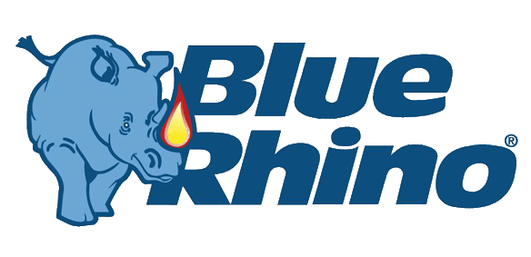
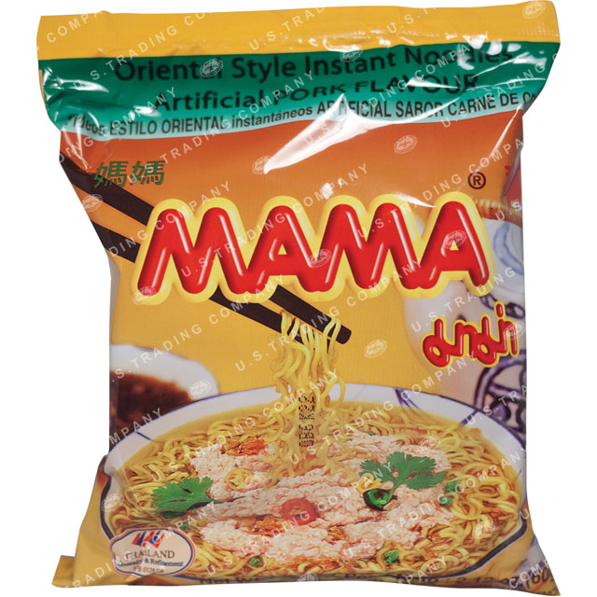


Slide 6
MEANINGFULNESS
Brand elements may take on all kinds of meaning, with either descriptive or persuasive content.
Two particularly important criteria
  General information about the nature of the product category
  Specific information about particular attributes and benefits of the brand
The first dimension is an important determinant of brand awareness and salience; the second, of brand image and positioning.

Slide 7
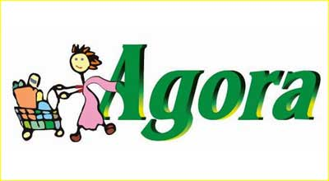

SCENERIO 1: A need arises for Grocery Shopping. Which store do you think of first?
SCENERIO 2: Which store would you choose for your everyday shopping? Why?

Slide 8
LIKABILITY
In order for a brand to be likeable, you need to ask yourself two questions in specific:
Do customers find the brand element aesthetically appealing?
Are the brand elements likeable visually, verbally, and in other ways?
Brand elements can be rich in imagery, and inherently fun and engaging, even if not always related to the product. EXAMPLE: lunchdad.com & Baymax.

Slide 9
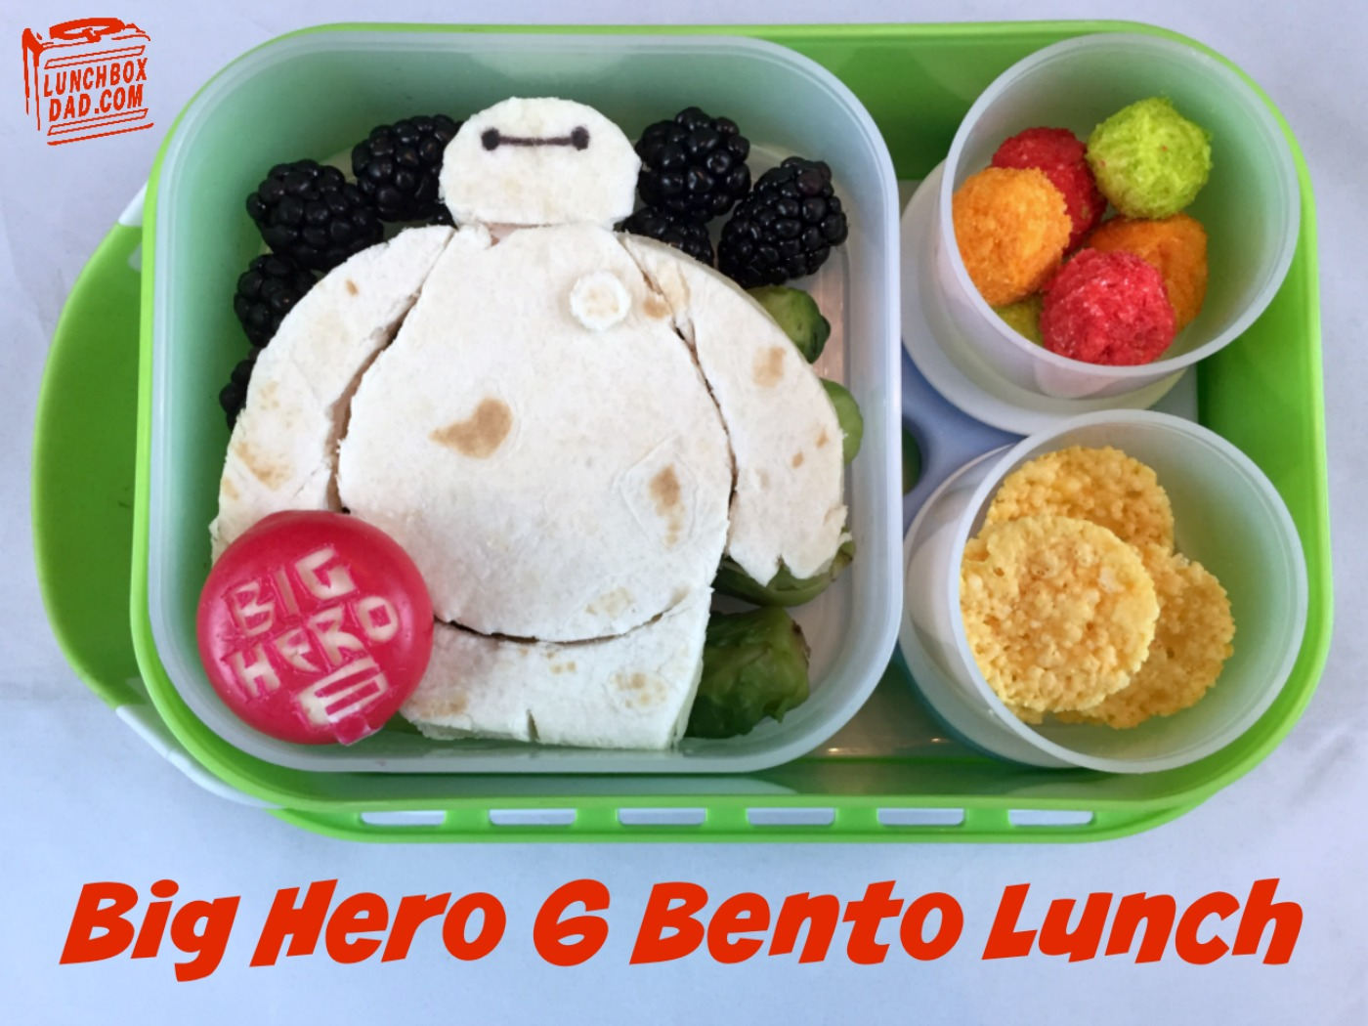

Slide 10
TRASFERABILITY
It measures the extent to which the brand element adds to the Brand Equity for new products or in new markets for the brand.
Two criteria:
How useful is the brand element for line or category extension? In general, the less specific the name, the more easily it can be transferred. EX: Amazon, Bashundhara, etc.
To what extent does the brand element add to brand equity across geographic boundaries and market segments? Culture is the key here. EX: Lumia (Spanish for “prostitute”), BARF detergent, FART (Polish for “lucky”) bar, etc.

Slide 11
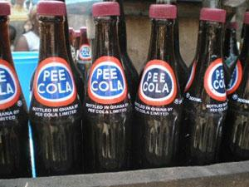
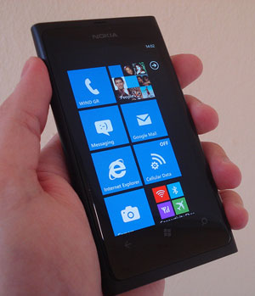
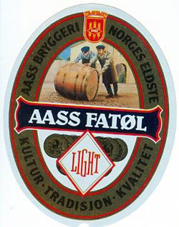
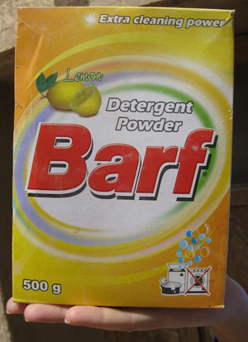


Slide 12
ADAPTABILITY
The more adaptable and flexible the brand element, the easier it is to update it to changes in consumer values and opinions.
For example, logos and characters can be given a new look or a new design to make them appear more modern and relevant.

Slide 13
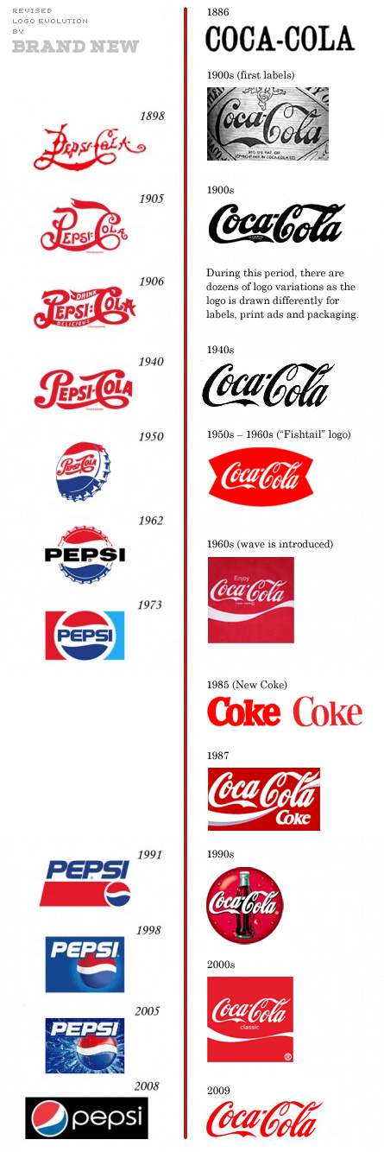


Slide 14
PROTECTABILITY
Marketers should:
Choose brand elements that can be legally protected internationally.
Formally register chosen brand elements with the appropriate legal bodies.
Vigorously defend trademarks from unauthorized competitive infringement.

Slide 15
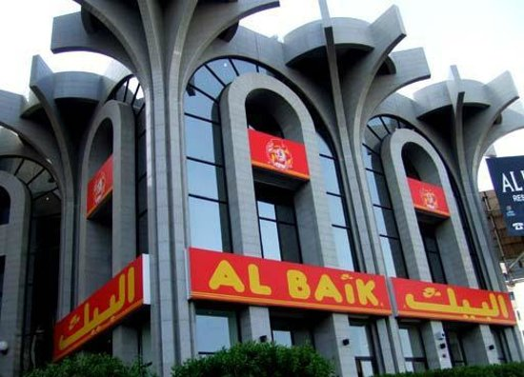
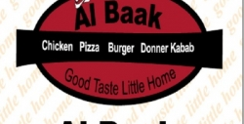

Slide 16
Brand Elements: BRAND NAMES
Landor’s Brand Name Taxonomy
Descriptive: Describes function literally; generally unregisterable, i.e. Singapore airlines
Suggestive: Suggestive of a benefit or function, i.e. head and shoulders, clear
Compounds: combinations of 2 or more, often unexpected words. i.e. RedHat
Classical: Based on Latin, Greek or Sanskrit i.e. Nike
Arbitrary: real words with no obvious tie in to company i.e. apple, orange, mango
Fanciful: Coined words with no obvious meaning i.e. Vodafone

Slide 17
Brand Elements: BRAND NAMES
NAMING PROCEDURES
Define objective
Generate names
Screen initial candidates i.e. cannot pronounce, double meaning, already in use, against the positioning
Study the candidates names i.e. international legal search
Research the final candidates i.e. consumer research
Select the final names

Slide 18


Slide 19
Brand Elements: URL’s
URLs (uniform resource locators) specify locations of pages on the web and are also commonly referred to as domain names.
Every 3 letter combination and virtually all words in the typical English dictionary have been registered
Companies change their brand name due to unavailability of simple brand names i.e. Andersen Consulting to Accenture
Another issue faced by brands are unauthorized use of brand name in other domains or domains that are similar in nature that could mislead the consumer
  Sue for infringement through the WIPO (an agency of UN)
Brand recall is important when it comes to URL, if you cannot remember you cannot go onto the site

Slide 20


URL Infringement (Example)
http://www.citigroup.com/citi/about/countrypresence/bangladesh.html
https://www.thecitybank.com/

Slide 21
Brand Elements: LOGO’s & SYMBOLS
Although the brand name typically is the central element of any brand, visual elements also play a critical role in building brand equity, and especially brand awareness.
As a matter of fact, VISUAL ELEMENTS play even a more crucial part in this than we may actually realize.

Slide 22


Slide 23
Brand Elements: LOGO’s & SYMBOLS
Brands with strong word marks
Examples of abstract designs
Literal representation of the brand name

Slide 24
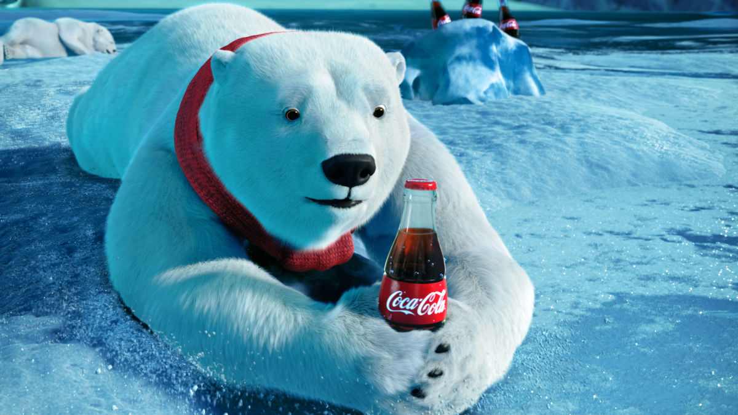
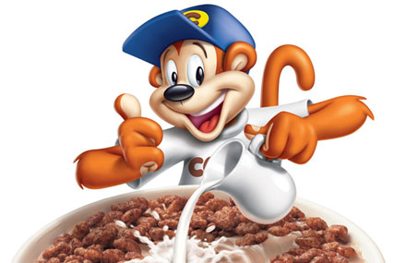
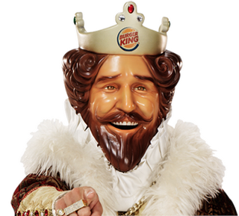
Brand Elements: CHARACTERS
A special type of brand symbol—one that takes on human or real-life characteristics.
Improves visibility
Enforces human values and characteristics than other elements
Provides licensing properties

Slide 25


Brand Elements: SLOGANS
Slogans are short phrases that communicate descriptive or persuasive information about the brand.
Slogans are powerful branding devices because, like brand names, they are an extremely efficient, shorthand means to build brand equity.
Helps consumers grasp the meaning of brands

Slide 26
CAN YOU THINK OF A BAD SLOGAN?

Slide 27
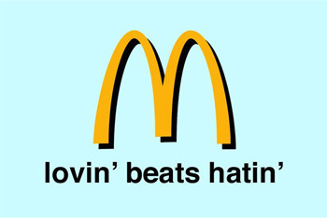
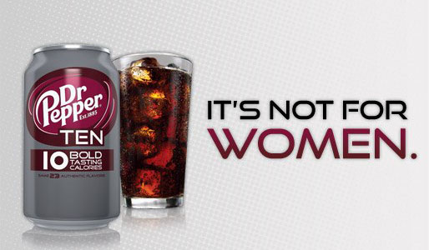


Slide 28
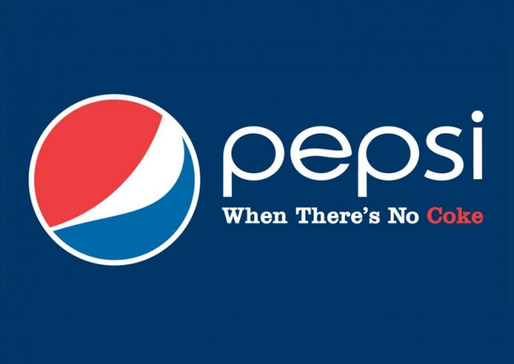

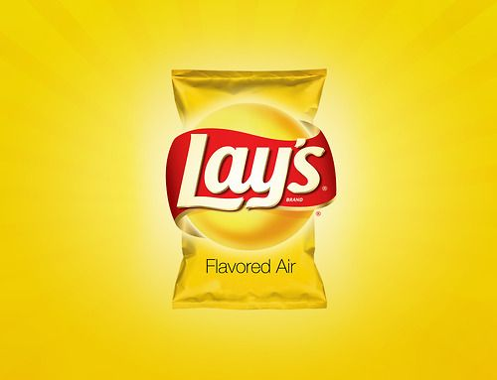

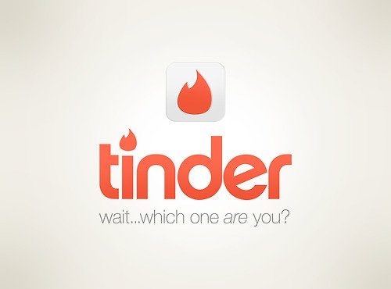
SLOGANS: What are we ACTUALLY thinking?

Slide 29
Brand Elements: JINGLES
Jingles are musical messages written around the brand. Typically composed by professional songwriters, they often have enough catchy hooks and choruses to become almost permanently registered in the minds of listeners—sometimes whether they want them to or not!
Jingles are perhaps most valuable in enhancing brand awareness.
Consumers mentally rehearse or repeat catchy jingles after the ad is over.

Slide 30
Brand Elements: PACKAGING
From the perspective of both the firm and consumers, packaging must achieve a number of objectives:
Identify the brand
Convey descriptive and persuasive information
Facilitate product transportation and protection
Assist at-home storage
Aid product consumption

Slide 31
Brand Elements: PACKAGING
PACKAGING TO IMPROVE BRAND IMAGE
Last 5 seconds of marketing
Silent salesman
Permanent media
ASK YOUR SELF THIS: Can packaging establish the brand promise within 3 seconds and 15 feet away? If “yes” then you have a winner!

Slide 32
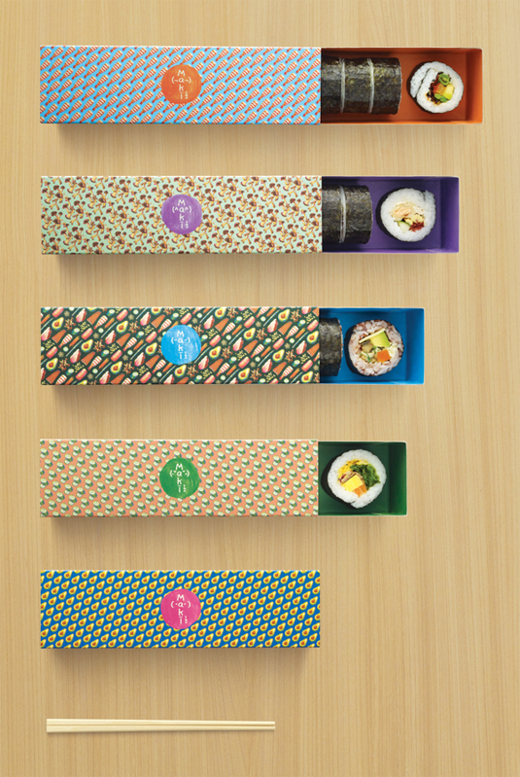
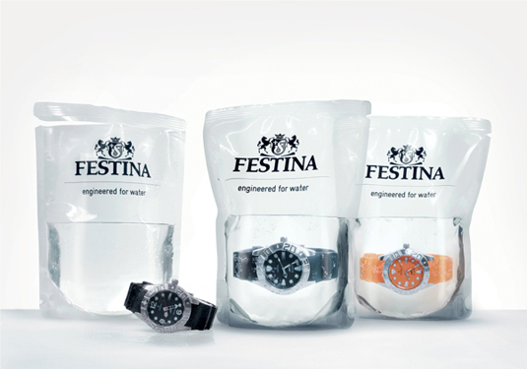
IMAGE: Festina Watches
IMAGE: Maki-san

Slide 33
Brand Elements: PACKAGING
PACKAGING INNOVATIONS
Packaging innovation help to gain short term growth in sales.
Why short term, because it can be copied

Slide 34
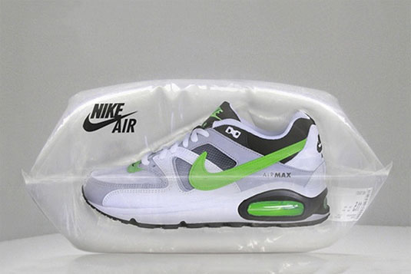
Innovative, yes! But does it beat the classic shoe-box design?

Slide 35
Brand Elements: PACKAGING
PACKAGE DESIGN
Need to stand out
Need to have “shelf impact”
There is a science that goes into packaging
  Colours, text, design etc.
Some products are linked with colour
So are brands

Slide 36
Brand Elements: PACKAGING
PACKAGING COLORS
White Packaging
In color psychology, white is the blank canvas waiting to be written upon. It relates to innocence, equality and new beginnings.
Black Packaging
Black is the color of power, authority and control. It tends to stand out when used as a packaging color as it makes products appear heavier and more expensive and transmits a higher perceived value.
Blue Packaging
Blue relates to trust, honesty and reliability, strength and unity. When used in your packaging colors it communicates trust and reliability in the product.

Slide 37


Slide 38
Brand Elements: PACKAGING
PACKAGING COLORS
White Packaging
In color psychology, white is the blank canvas waiting to be written upon. It relates to innocence, equality and new beginnings.
Black Packaging
Black is the color of power, authority and control. It tends to stand out when used as a packaging color as it makes products appear heavier and more expensive and transmits a higher perceived value.
Blue Packaging
Blue relates to trust, honesty and reliability, strength and unity. When used in your packaging colors it communicates trust and reliability in the product.

Slide 39




Slide 40
Brand Elements: PACKAGING
Red Packaging
In color psychology, red means energy, action, passion, excitement and strength.
Green Packaging
Green is a color of balance and harmony of the mind, the body and the emotions. In color psychology it relates to security, wealth and growth.
Orange Packaging
In color psychology, orange means adventure, optimism, self-confidence and sociability. It is enthusiastic, extroverted and uninhibited.

Slide 41
Brand Elements: PACKAGING
Yellow Packaging
Yellow is cheerful, optimistic and uplifting to the spirits. It inspires original ideas and creativity. Stimulating to mental abilities, it aids in decision making.
Turquoise Packaging
Turquoise, in color psychology, means clarity of thought and communication. It calms the emotions and recharges the spirit, invigorating depleted energy levels and inspiring positive thought.
Purple Packaging
Purple relates to high ideals, imagination and spirituality. Using purple in your packaging colors implies luxury, extravagance, premium quality or uniqueness, particularly if used with gold or silver printing or decoration.

Slide 42
Brand Elements: PACKAGING
Magenta Packaging
Magenta is a strong and inspiring color which can appear outrageous and shocking on one hand or innovative and imaginative on the other.
Pink Packaging
Pink is inspiring, warm, compassionate and comforting, suggesting hope for the future. It is calming and non-threatening.
Gold Packaging
Gold packaging suggests expensive, luxurious and high quality. However your product should reflect this high standard or you will lose credibility - a poor quality product inside gold packaging will appear cheap and have the same effect as fake gold!

Slide 43
Brand Elements: PACKAGING
Silver Packaging
Silver packaging implies elegance and sophistication. It is more gentle than gold and it combines well with almost all other colors illuminating anything printing or decorating on the packaging.
Gray Packaging
Gray is a conservative color signifying neutrality, indifference and reserve. It lacks energy but serves well as a background color, allowing other colors with it to take prominence.
Brown Packaging
Psychologically, brown is associated with strength and solidarity, comfort and earthiness, maturity and reliability.

Slide 44
Brand Elements: PACKAGING
PACKAGE CHANGES
Do you think packaging changes are expensive?
Reasons firms change their packaging?
  To signal a higher price
  To sell effectively sell through new or shifting distribution channels
  Product line expansion
  To introduce new product innovations
  The old package looks outdated
Do not change the packaging to confuse the customer. The customer will not recognize the brand
Packaging is considered to be the 5th P of the marketing mix

Slide 45
PUTTING IT ALL TOGETHER…
The entire set of brand elements makes up the brand identity, the contribution of all brand elements to awareness and image.
The cohesiveness of the brand identity depends on the extent to which the brand elements are consistent.

Slide 46


