Slide 1
“Brands and Brand Management”
A holistic overview.

Slide 2
Presentation Outline
Significance of the environment with the brand.
What is a brand?
Different types of brand names
Why are brands important?
Challenges & Opportunities of branding
The brand Equity Concept
Strategic Brand Management Process

Slide 3
What is a brand?
American Marketing Association Defines Brand as:
“Name, term, symbol, sign, or design, or a combination of them, intended to identify the goods and services of one seller or group of sellers and to differentiate them from those of competition”

Slide 4
Brands are a collection of associations

Slide 5
Does this Image portray the associations ?

Slide 6
What about this one?

Slide 7
What is Brand Equity?
“According to Stuart (1956), “If this company were to split up I would give you the property, plant and equipment and I would take the brands and the trademarks and I would fare better than you”.
Example: Meril Winter Care.

Slide 8
Different types of Brand Names

Slide 9
Types of brand names # 1
Some companies use a “brand name” on generally all their products:
For Example: Tibet washing powder, Tibet toothpowder, Tibet beauty soap, Tibet Shaving cream, Tibet Snow, Tibet chandan attor, Tibet 570 soap, Tibet lip jel…and the list goes on!
Discussion: So what is the brand “Tibet” in the consumer’s mind? Different consumers will give you different opinions. What is Tibet’s positioning?
Tibet has violated one of the basic laws of branding “law of contraction”
The easiest way to destroy a brand is to put its name on everything. That is why Tibet is not a market leader in any category it is doing business in.

Slide 10
The Law of contraction
A brand becomes stronger when you narrow its focus.
E.g. Meril has narrowed its focus on “winter care”. It contributes to almost 20% of overall company revenue and is currently the market leader in the winter care category of Bangladesh.
Other Examples Include Senora which focuses on the sanitary napkin category only.
A powerful branding program always starts by contracting the category, not expanding it.
However, companies want to be very business oriented and do not want to invest to establish a new brand.

Slide 12
Types of brand names # 2
Companies assign individual brand names that are unrelated to the company name:
Square Toiletries Limited’s: Whiteplus, Chaka, Kool, Magic.
Unilever’s: Pond’s, Wheel, Sunsilk, Dove.
P and G’s: Tide, Head and shoulders, Pampers.

Slide 14
Types of brand names # 3
Brand names are assigned according to people’s names:
Example: Jui, Meril, Paul Mitchel, David Beckam, Beyonce.
When brands names are of a specific celebrity name, there is a sudden acceptance of the brand amongst the massive fan base the celebrity possesses.
Same thing occurs when a celebrity endorses a brand. E.g. Lux, Olay, Head and Shoulders, channel no. 5 etc.
You buy the star and you get the sales!

Slide 16
Types of brand names # 4
There are brand names based on places:
Example: Dhaka FM, Biman Bangladesh Airlines, Philadelphia Cheese.
There are brand names based on animals:
e.g. Dove, CAT, Caterpillar.

Slide 20
Types of brand names # 5
Some brand names have inherent product meaning:
Examples: Vanish, Saaf, Xpel, fair and handsome.

Slide 23
Importance of understanding the Customer

Slide 24
Customer needs, wants and demands
Needs
Maslow’s hierarchy of needs.
Wants
Demands
Form that needs take as they are shaped by culture and individual personality – objects that satisfy needs.
Wants backed by buying power
States of deprivation

Slide 25
WHAT IS THE ONE QUESTION YOU CANNOT AFFORD TO GET WRONG?

Slide 26
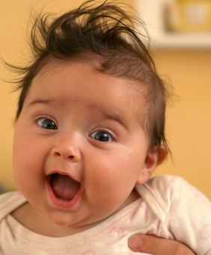
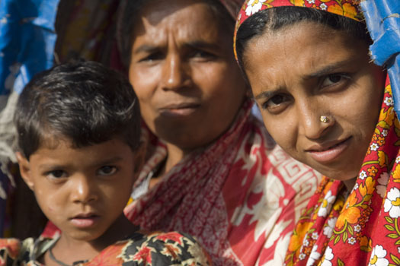
Who is your Customer?

Slide 27
Zero in on your Consumer
What is the environment?
Which segments?
Within each segments
which are the target segments?

Slide 28
How do you understand the Consumer?
Focus group and other research studies
Consumer immersion

Slide 29
Different Levels of a product
Augmented Product level
Actual product level
Core benefit level

Slide 30
EXAMPLE
Warranties, after sales service.
Portable MP3 Player
Music entertainment on the move

Slide 31
Why are brands important?
For consumers:
Identification of the source of the product in terms of the producer.
Risk Reducer – due to previous experience with different brands, they can trust a specific brand to address their needs. Hence, simplifies purchase decision making.
Search cost reducer: If consumer recognize the brand and have knowledge about it, then they do not have to engage in a lot of additional thought or processing of information to make a purchase decision. Hence search cost is reduced internally (in terms of how much they have to think) and externally (in terms of how much they have to look around).

Slide 32
Why are brands important? [continued]
Source of bond with the consumer: consumers become loyal to the brand provided that satisfaction has occurred from past purchases.
Symbolic device: allow them to project self image. Example: Chanel 5 (classy image).
Symbol of quality.
Conclusion: In short, a brand reduces risk and simplifies purchase decision making.

Slide 35
Why are brands important?
For firms:
For firms, brands are the most valuable asset of the company. Hence, a trademark/copyright should be implemented so that others cannot sell the product under the brand name.
As brands are a signal of quality to satisfied customers – repeat purchase occurs which secures demand and revenue for the company. Source of financial returns: Strong brands = better earnings = profitability.

Slide 36
Challenges and Opportunities of Branding

Slide 37
Challenges and Opportunities of Branding
Consumers Expectations – the gap between performance and expectation is growing.
Companies need to continuously improve the quality of the product to keep up with the expectations of the consumers.
Brands need to be emotionally attached to the consumers. In other words, A brand should possess emotions. Once you make a brand possess emotions, you strengthen the brand and consumers will tend to like that brand.

Slide 40
Challenges and Opportunities of Branding [continued]
Brand Proliferation:
Different product ranges from different categories are being branded under an umbrella brand. As a result such an act violates the law of contraction and weakens the brand.
Example1: Jui entered the shampoo market with “Jui Sense of Balance”. Very Risky. Heavy marketing investment done. Product quality was not up to the mark. Big failure.
It’s a big challenge for marketers to make sure that the brand is well sustained while entering other product categories.
Discussion: How do you face this challenge?

Slide 42
Challenges and Opportunities of Branding [continued]
Media:
Traditional advertising media is getting fragmented
Cost – To get a reasonably good exposure of a new TVC – at least 70 lacs needs to be spent in Bangladesh now! To get that return of marketing investment it takes brands months to reach breakeven.
Clutter – Too many adverts going on. Its getting harder to grab consumer’s attention.
Fragmentation – Variations of TV/Radio stations are growing. More and more people are subscribing hindi channels. Its difficult to reach the target consumers.
Technology factor – which enables consumers to avoid commercials.
BUZZ MARKETING, GEURILLA MARKETING, Non traditional media which is more interactive is emerging: e.g. outdoor branding and event sponsorship, market activations, superstore shelf branding etc.

Slide 43
Challenges and Opportunities of Branding [continued]
Increased Competition
Happens due to:
Globalization: Threat of new entrants who want to enter your market as a source of more revenue.
Low Priced Competitors: chinese products, and their main bargain is low cost.
Brand Extensions: many companies might extend their existing brand into a new category which is a threat.
Deregulation: when government reduces its role and allows an industry a greater freedom in how it operates. More freedom will lead to more competition.

Slide 44
Challenges and Opportunities of Branding [continued]
Increased Cost:
More Competition = More investment needed to establish a new brand or supporting an existing brand.
Because of this factor many new brand eventually fail which is another reason why marketers decide to go for a “brand extension” to enter a new product category.
Greater Accountability:
There exists a pressure to meet short terms revenue and profit targets.
This might create adverse long term effects on the brand.
e.g. Shakti Toilet Cleaner – all eyes of Shakti and how much it is spending.

Slide 45
The brand equity concept – simplistic form
1. You make a product
2. You give it a brand name
3. You tell the consumer how great and unique the brand is
4. The consumer listens to you and goes out to buy the brand
5. They realize how great it is (satisfaction)
6. They value you brand and are loyal to it

