Slide 1
CUSTOMER BASED BRAND EQUITY

Slide 2
Collaborative Consumption
The shared use of a good or service by a group.
Collaborative consumption is considered part of the sharing economy because it means that individuals are renting out their underused assets. By renting out an asset when it is not being used, its owner is turning the asset into a sort of commodity and creating a scenario in which physical objects are treated as services.

Slide 3
Significance of Collaborative Consumption in EARNING MONEY

Slide 5
360 Degree Branding
360 degree branding signifies the notion of surrounding the customer or prospect with a brand’s messages.
It is a phrase that suggests that a brand’s touch points should be everywhere the target audience is.
“we want to be everywhere that makes sense for our customer. We go to the places they are”- Ford’s marketing manager.

Slide 6
360 Degree Branding
touch point refers to any message medium capable of reaching target customers and presenting the brand in a favorable light.
Before the touch point was ATL (above the line communication) oriented. However, now companies have shifted towards a BTL (below the line) approach to effectively communicate a brand’s message to their target consumers.

Slide 7
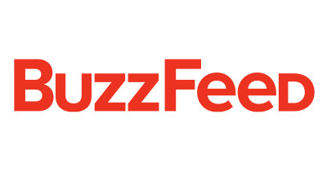
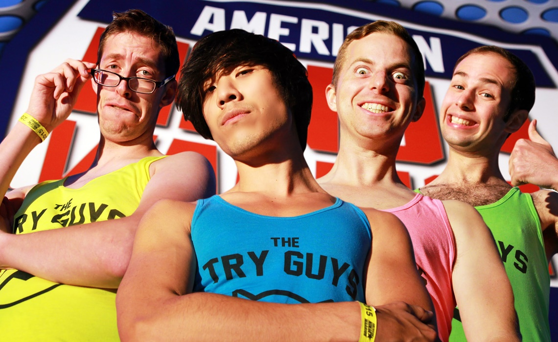

Slide 8
ATL & BTL
Above the line (ATL) communication uses traditional mass media as a medium to promote brands and reach out to target consumers.
ATL technique majorly employs TV and radio advertising, print advertising and internet banner ads.
ATL communication presents the message to the target consumers AND ALSO consumers who DO NOT belong to the brand’s target group.
Hence, don’t you think a lot of money is being wasted? Because you are spending money to talk to consumers who are NOT YOUR target consumers.

Slide 9
ATL & BTL
Below the line (BTL) communication techniques are devised to reach consumers directly through alternative forms of marketing other than traditional advertising channels used in ATL.
Example: direct marketing, personal selling, public relations and other unique ways like the what Lifebuoy did in India. [Roti Ad]
BTL communication ONLY reaches the target consumers of the brand which is why its IMPACT is stronger. That’s the beauty of it. You are spending money to talk to consumers (communicate) who are YOUR target consumers ONLY.

Slide 10
What is Customer Based Brand Equity?
“Customer based brand equity is the differential effect that brand knowledge has on consumer response to the marketing of that brand”.

Slide 11
Customer Based Brand Equity [continued]
Three key ingredients of the definition:
Differential effect: The brand needs to be unique and different in the minds of the consumer. Hence, the starting point of establishing a strong brand equity is crafting a unique brand positioning.
Brand Knowledge: this differential effect needs to be communicated to the consumers and that is how consumers will have a knowledge about your brand (this is when brand equity is created). This knowledge is created through the sources of brand equity explained before.
Consumer response to marketing: signifies the outcomes of brand equity.

Slide 14
Brand Knowledge
Brand Knowledge is the key to creating Brand Equity.
Marketers need to make sure that the right knowledge about the brand exists on the minds of the consumers.
Brand Knowledge is a very complex structure. We need to understand the parameters that form the brand knowledge construct.
Brand Knowledge = Brand Awareness + Brand Image.
Brand image is the summation of all the brand associations that exists in the minds of the consumers.
Brand awareness = brand recognition + brand recall.

Slide 15
Possible Associations of the brand “Apple”
User friendly
Fun
creative
Innova-tive
Ipod, Iphone, Ipad

Slide 16
Possible Associations of the brand “Fair & Handsome”
Handsome
Shahrukh Khan
desirable
Fair skin

Slide 17
4 Steps in Building a Strong Brand
Consumers’ understanding about who is this brand – The brand Identity.
Consumer’s understanding about what are the associations of a brand which can be functional and emotional in nature – Brand Meaning.
Consumer’s reactions / perceptions / feelings about a brand which is usually after consumption – Brand Responses.
Consumer’s connection and bond with a brand – Brand relationships.

Slide 18
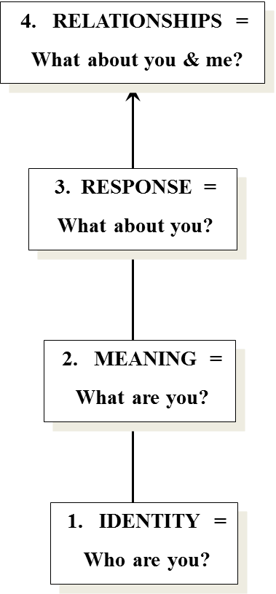
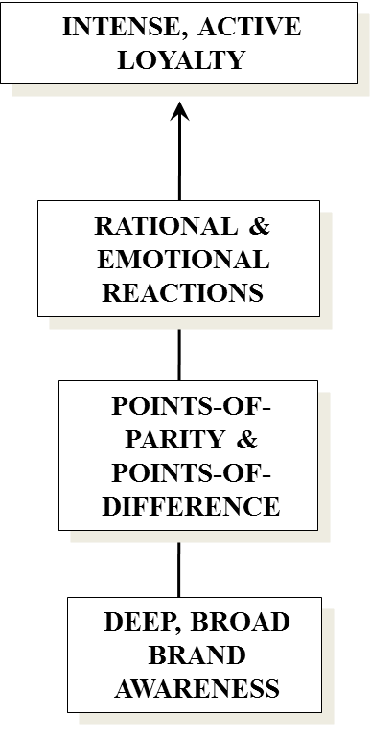
The CBBE Model

Slide 19
Brand Salience
Brand Salience is the degree to which your brand is thought about or noticed when a customer is in a buying situation. Strong brands have high Brand Salience and weak brands have little or none.
There exists four steps via which the foundation of the brand equity model (a.k.a. brand salience) can be established.

Slide 20
Brand Salience
Step 1: Giving the new product/service a unique brand name.
Step 2: Creating a link between the brand and the category the brand belongs to and the need that the brand addresses.
Step 3: Creating a link between the brand and the usage and purchase situation. This is also referred to as the Breadth of Brand Awareness.
Step 4: Ease of recall (also referred to as Depth of Brand Awareness)
When the need arises
When the category is mentioned
During purchase situation
During Usage situation

Slide 21
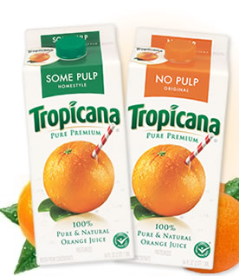
Understanding depth and breadth of brand awareness
Need: “tasty and healthy” drink.
Category: Orange juice.
Breadth of brand awareness
Purchase situation: which type of beverage should I buy? Something that is tasty and healthy.
Usage/consumption situation: for breakfast.
Depth of brand awareness
Ease of recalling Tropicana when thinking of orange juice.
Ease of recalling Tropicana when needing a tasty and healthy drink.
Ease of recalling Tropicana during breakfast time.
Ease of recalling Tropicana during purchase situation.

Slide 22
Strategic implications of brand salience
Proper implications of brand salience can lead to greater revenues.
Example 1: In winter 2011, Meril campaigned about how the product can be used not just on the lips – but also on the cheeks, feet, hands to increase consumption and generate more revenue (breadth of brand awareness).

Slide 23
Strategic implications of brand salience
Example 2: Spring Air Freshener usage in homes, cars, and office.

Slide 24
Strategic implications of brand salience
Example 3: In year 2011, Harpic campaigned to increase the consumption of toilet cleaner by communicating to use harpic “everyday”.

Slide 25
Strategic implications of brand salience
Example 4: Shocking campaign of Pran Mango juice in winter 2011.

Slide 26
Understanding the Brand Salience of Nando’s?

Slide 27
Brand Performance
“Quality” simply means the ability of a product/service to effectively and efficiently satisfy consumer needs.
How well does Dove soap clean and moisturize your skin?
Quality is a significant parameter to enhance brand value. Brand equity can never be built based on negative product/service quality.
Brands such as Jui sense of balance and Shakti were a failure because of its poor product quality.
Quality can be a source of “differentiation” as quality can give consumers a compelling reason to purchase a brand.

Slide 28
Brand Imagery
Brand Imagery is a process via which we can humanize a brand. In other words, we can give a brand some human characteristics.
As a result, consumers will love a brand not only because of its brand performance but because of its human characteristics as well.

Slide 30
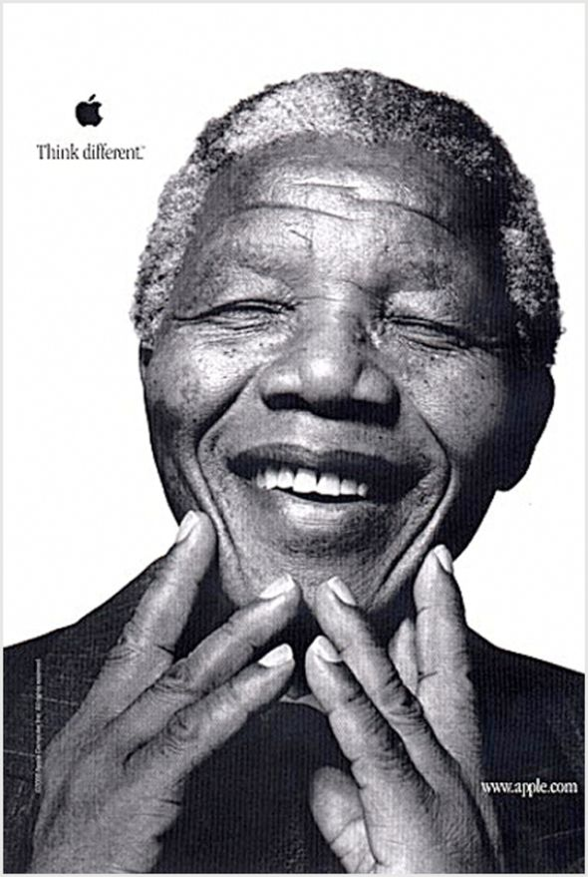

Slide 32
Emotional Branding through Brand Imagery
Brand Personality
Brand Heritage
User Profile

Slide 33
Brand Personality Framework

Slide 34
Brand Heritage: WALKER

Slide 35
Brand Heritage: CHEVROLET

Slide 36
User Profile: BLACKBERRY

Slide 37
User Profile: KEVIN HART & NIKE

Slide 38
Brand Judgments
Brand Judgments signifies consumer’s opinions about and evaluations of the brand which consumers form by putting together all the different brand performance and imagery associations. Brand judgments are created because the consumer has already experienced the brand.
Customer satisfaction is the person’s feeling of pleasure or dissatisfaction resulting from comparing a product’s perceived performance in relation to his/her expectations. Discussion example: Biman Bangladesh Airlines.
Customer value is the customer’s evaluation of the difference between all the benefits and all the costs of a market offering relative to those of competing products. Discussion example: designer clothes.

Slide 39
Brand Judgments [continued]
Brand Credibility: perceived expertise (innovative, market leader), trustworthiness (true in what the brand offers and are customer centric) and likability. EXAMPLES.
Brand Consideration: How strong and favorable brand associations are created for consumers to actually consider making a purchase. This theory is similar to purchase intention.
Brand Superiority: how unique and better the brand is compared to its competitors.

Slide 40
Brand Feelings
Brand Feelings are customer’s emotional responses and reactions to a brand.
Fantasy Kingdom/Water Kingdom will give you a feeling of having fun.
Parachute will make you feel gorgeous all the time.
Peace of mind/ secured delivery of your package (DHL).
Hallmark cards (a feeling of being sentimental).
Feeling of being Socially approved (Mercedez).
Insurance companies will give you a sense of security.

Slide 41
Brand Resonance
“If I love a brand, how much am I ready to do for it…” Brand Resonance describes exactly how intense (deep) and active is the consumer’s relationship with the brand.
Brand Resonance has four dimensions:
Behavioral Loyalty
Attitudinal attachment
Sense of community
Active engagement

Slide 42
Brand Resonance [continued]
Behavioral Loyalty is all about repeat purchases and volume purchases of a specific branded product.
In other words, brands need to create behavioral loyal consumers who will generate the most revenue and profit.
Bangladeshi people mostly want to buy Toyota cars because of many factors – Imagine how much money will the company make from a single behaviorally loyal consumer if he/she buys at least 3 cars in their lifetime.

Slide 43
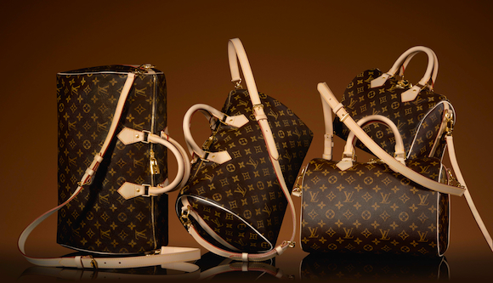
Brand Resonance [continued]
Attitudinal Attachment is needed to create a strong personal attachment to the brand. Consumers need to “Love” the brand, it should be their “favorite possession”.
Example: LV bags, Apple, Loubs.

Slide 44
Brand Resonance [continued]
Sense of Community: “Sense of community is a feeling that members have of belonging, a feeling that members matter to one another and to the group, and a shared faith that members’ needs will be met through their commitment to be together” (McMillan, 1976).
Influenced by:
Membership
Influence
Integration & Fulfillment
Shared Emotional Connection

Slide 45
Brand Resonance [continued]
Active engagement occurs when consumers invest additional time and other resources in the brand and become brand ambassadors and communicate about the brand to others and build stronger brand ties with others.
IN CONCLUSION Brand Resonance needs intensity (attitudinal loyalty and sense of community) and activity (behavioral loyalty and active engagement).

Slide 46
Building the right Relationship with the right Customer

Slide 47
Building the right Relationship with the right Customer
Butterflies: Good fit between company’s offering and customer’s needs; high profit potential. However, they tend to only be behaviorally loyal. E.g. Buy 1 Spring Air Freshener and get 1 Meril Splash Xtra Fresh soap free.
True friends: Good fit between company’s offering and customer’s needs; highest profit potential. They are both attitudinally and behaviorally loyal. Company should invest in them the most.
Strangers: Little fit between company’s offerings and customer’s needs; lowest profit potential. Simple rule: Don’t invest anything in them.
Barnacles: Limited fit between company’s offerings and customer’s needs; low profit potential. If they cannot be made profitable they should be removed from the system. E.g. Zara on Boxing Day.

Slide 48
THANK YOU!

