Slide 1
BRAND POSITIONING

Slide 2
The STP Analysis

Slide 3
Market Segmentation
Market segmentation is dividing a heterogeneous market into distinct homogeneous groups that have (i) similar needs and (ii) respond similarly to a marketing program.
Four characteristics of market segmentation:
Individuals or businesses within the segment should be homogeneous.
The segment should differ from other segments.
The segment should be large enough
It should be reachable through some type of media OR channels of distribution.

Slide 4
Market Segmentation [cont.]
Bases of Segmentation:
Geographic segmentation
Demographic segmentation
Socio-economic class (a subset of demographic segmentation).
Psychographic segmentation
Behavioral segmentation
Benefit segmentation (a subset of behavioral segmentation).

Slide 5
Market Segmentation [cont.]
In the geographic segmentation approach, markets are divided into different geographic units. These units may include nations, cities, or even neighborhoods.
Demographic segmentation divides the market into groups based on variables such as age, gender, family size, birth era, household size, life stage, religion, race, Marital status and nationality.
Demography is the study of human population. It involves statistics related to humans and that is why it is important because humans make up consumer markets.
Socio economic class (SEC) is the society’s relatively permanent and ordered division. It is measured by a combination of occupation, income, and education.

Slide 6
SOCIO ECONOMIC CLASS OF BANGLADESH (By Nielsen)
SEC (GROUP A)
2.42 % of total Population
He/she is businessman/businesswomen or a service holder (mid/senior)
His/her income level is 40,000 BDT or more per month.
Has a bachelors degree or more.
SEC (GROUP B)
13.28% of Total population
He/She is a house owner or officer/executive (mid/senior)
His/Her income level is minimum 10,000 BDT to maximum 30,000 BDT.
Has a Bachelors degree.

Slide 7
SOCIO ECONOMIC CLASS OF BANGLADESH (By Nielsen)
SEC (GROUP C)
15.67% of Total population
Income level generally lies between BDT 6,000 to BDT 20,000.
SSC/HSC graduate, Diploma degree.
Supervisor
SEC (GROUP D)
30.29% of Total population
He might be a shop owner, salesman
Income level generally lies between BDT 5,000 to BDT 15,000
Has completed high school.

Slide 8
SOCIO ECONOMIC CLASS OF BANGLADESH (By Nielsen)
SEC (GROUP E)
38.33% of Total population
Unskilled labor.
Income level : BDT 3,000 to BDT 10,000
Uneducated

Slide 9
Market Segmentation [cont.]
Psychographic segmentation divides the market on the basis of human personality and lifestyle.
Lifestyle is a person’s pattern of living and how they interact in the world. Example: healthy lifestyle, trendy lifestyle, adventurous lifestyle.
Personality refers to the unique psychological characteristics. Some parameters of personality: self confidence, dominance, sociability, autonomy, adaptable, aggressive.

Slide 10
Market Segmentation [cont.]
Behavioral segmentation divides consumers into groups according to the following characteristics:
User status: non-users, ex-users, potential users, first time users, regular users. Blood bank (regular donors, first-time donors, ex donors), non branded oral care product users (potential).
Usage Rate: light user, medium user, heavy user. Industrial marketers refer to the 80-20 rule, meaning 20% of their buyers account for 80% of their sales volume.
Loyalty status: low, high (example Apple diehards). How likely are they to switch brands? Will Pepsodent toothpaste users shift to Magic toothpaste if launched?
Buyer involvement: High (special effort), low (minimum effort).

Slide 11
Market Segmentation [cont.]
Benefit segmentation: In purchasing products, consumers are generally trying to satisfy specific needs. Hence, they are looking for products which provide specific benefits that satisfies these needs. The grouping of consumers on the basis of the benefits they are looking for in a product is known as benefit segmentation.
Example: The sensitive segment (medi plus, sensodyne), the healthy segment (pepsodent, white plus, colgate), the fresheners (close up, freshgel), the economic (Magic, pepsodent), the whitening (pepsodent whitening, medi plus whitening, toothpastes which removes cigarette marks etc.)

Slide 12
Target Marketing
Target Marketing signifies the process of choosing which consumers a business wants to serve. The market targeting process involves two steps:
Determining how many segments to enter
Determining which segments offer the most potential

Slide 13
Target Marketing [cont.]
Determining how many Segments to enter
Undifferentiated marketing: involves ignoring segment differences and offering just one product or service to the entire market. In such cases, a marketer designs one marketing mix for the whole market. This strategy helps to keep the cost down through economies of scale. Example: Lux beauty soap.
Differentiated marketing: involves marketing in a number of segments and developing separate marketing program for each. However, this increases the cost for the company.
Example: Pepsodent toothpaste, Shakti Doi.
Concentrated marketing: involves firms selecting one segment and attempting to capture a large share of this market by utilizing one marketing mix. Usually we see firms with limited resources pursue this strategy, however larger firms are now capitalizing on this strategy as well.
Example: Sensodyne. Premium brands and luxury brands pursue this strategy as well as they target affluent consumers only.

Slide 14
LUX (Mass Marketing)

Slide 15
SHAKTI DOI (Differentiated Marketing)

Slide 16
Target Marketing [cont.]
Determining Which Segments Offer The Most Potential
In order to determine which segments offer the most potential, the firm must examine:
The sales potential of the segment: Signifies how many potential consumers exist in the segment and how much is the market worth in terms of value.
The opportunities of growth of the market: signifies the growth rate of the market which has an impact on attractiveness of the market.
The competition in the market: are there strong multinational and local companies already competing in the market? Competition in the marketplace has an impact on market attractiveness.
Company’s own resources: the internal strengths and weaknesses should be analyzed as to whether the company can actually deliver superior value to the customers.

Slide 17
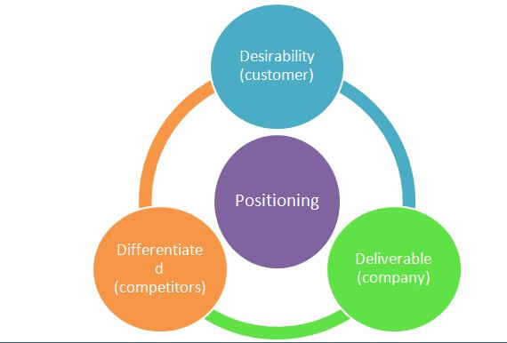
Positioning
Positioning occurs in the customer mindset. In other words, a company, via communication, positions the superior benefit of a brand in the customer mindset.

Slide 18
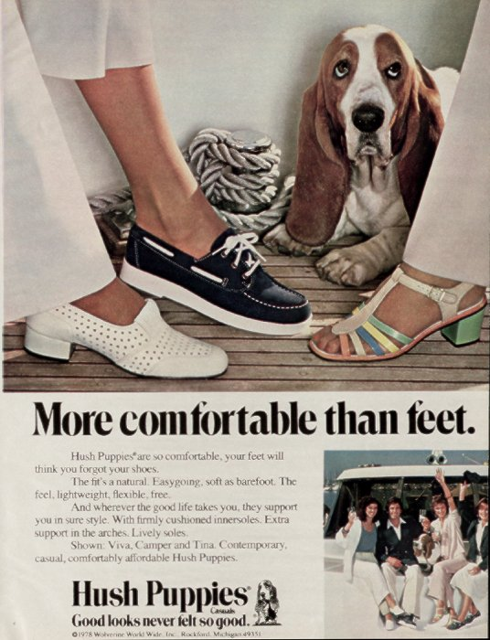

Slide 20
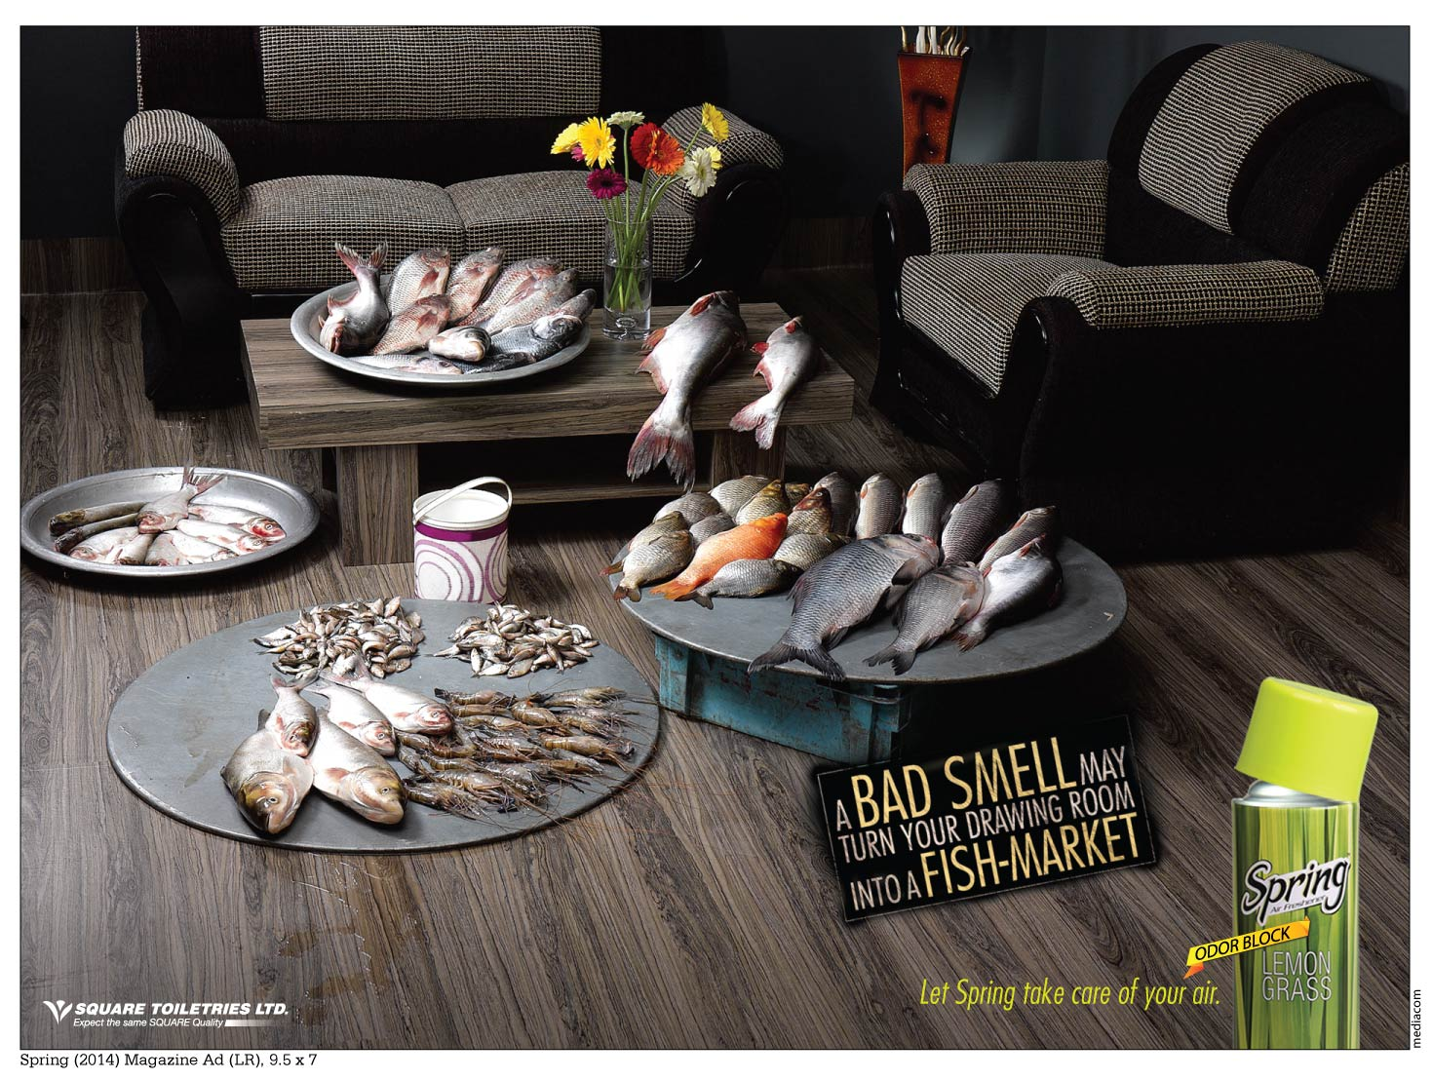

Slide 21
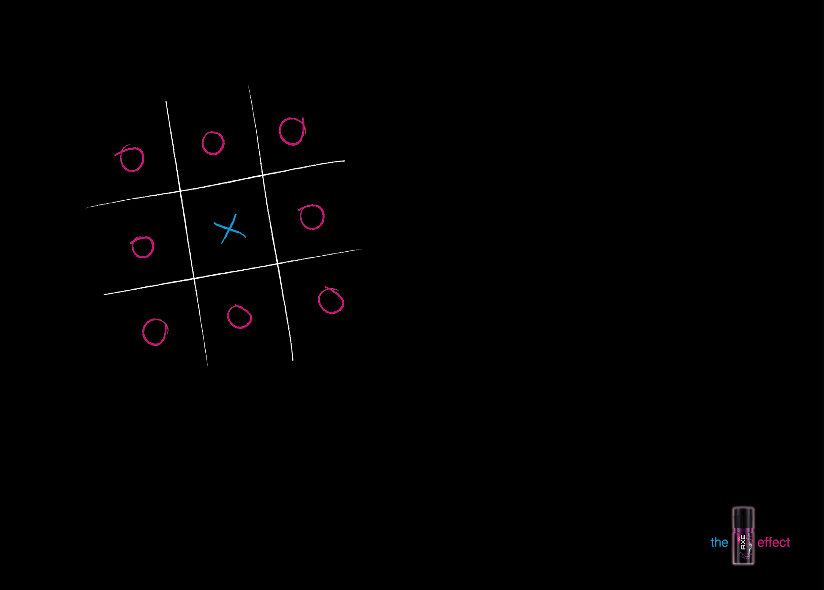

Slide 22
Positioning Strategies by David Aaker and Gary Shansby
Positioning by product attributes: signifies providing a unique feature to the consumers which the competitors currently do not possess.
Example: Dove Soap, Iphone Siri.
Positioning by benefits: focuses on the functional benefits that a product offers.
Example: Colgate protects the teeth from cavities; Bata provides durable footwear; Lifewater is a vitamin rich water.
Positioning by price: the benefit that the brand provides to the consumers is low price.
Example: Walmart.

Slide 23
Positioning Strategies by David Aaker and Gary Shansby
Positioning by quality: reflect the image of a high quality brand where price is considered secondary.
Example Rolex watches, and Lexus cars.
Positioning by emotional benefits: The intangible benefits a brand provides to its consumers if they possess a brand.
Example: Channel No. 5 (classy).
Positioning by product user: by associating a brand with a particular user or group of users.
Example: Airtel positions itself by the user group of students; Blackberry positions itself by the user group of corporate executives.

Slide 24
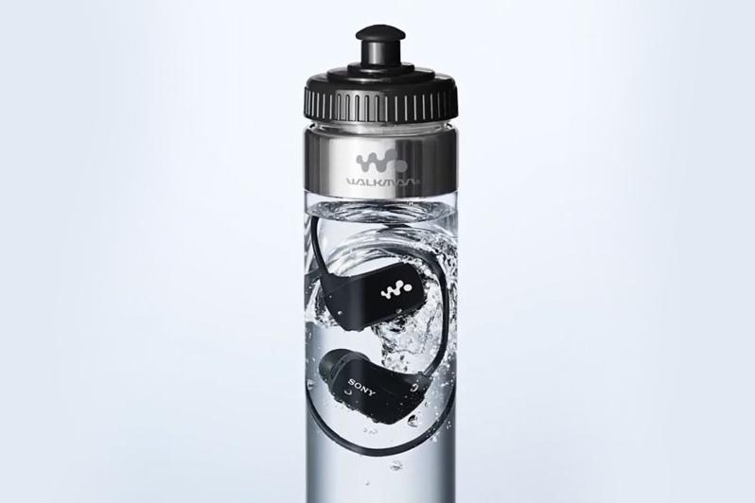

Slide 26
Positioning Strategies by David Aaker and Gary Shansby
Positioning by product class: can be done if two products lie in the same product class. Thus by joint promotions, both of these products improve their positioning. Positioning by product class mainly uses sales promotion as it tool.
Example – Get a toothbrush with a toothpaste free. Both of these products lie in the same product class and hence can be positioned accordingly.
Positioning by competitor: focuses on communicating how a brand’s benefits is different or better than the other competitors within the same product category.
Example: Avis “we are number two, so we try harder” or how Grameen phone network is better.
Positioning by brand character: by associating a brand with a meaningful brand character, the brand can easily make consumers understand the positioning of a brand and how differentiated it is from others.
Example: Louie the fly (Mortein), Commander Safeguard (Safeguard), Koala (Cushelle).

Slide 27
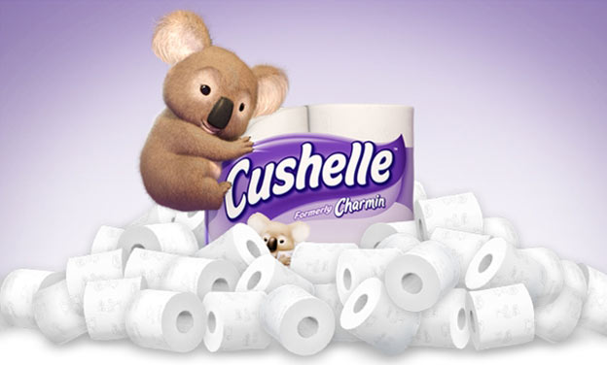

Slide 29
Nature of Competition
One of the primary differences between direct and indirect competitors is the business type.
In order to be considered a direct competitor, the competing business must be in the same specific industry as the company under consideration.
For example, direct competitors of a movie rental store would be other movie rental stores and rental Netflix.
Indirect competitors, on the other hand, would be stores that offer the same product or service, but not as their primary service.
Example: In the case of a movie rental store, this might include grocery stores or other retailers that include movie rental departments.

Slide 30
Points-of-Difference (POD) vs Points-of-Parity (POP)
Points-of-difference (POD): The aspects of the product offering that are relatively distinct to the offerings of like competitors.
Points-of-parity (POP): The aspects of the product offering that are largely similar to the offerings of like competitors.
An appropriate balance is required for market success. Too much reliance on points-of-parity in the product’s positioning and it could be perceived as a ‘me-too’ product offering. And too little emphasis on points-of-parity and the product might be perceived as not meeting the core needs for the target market.

Slide 31
Unique Selling Proposition (USP) & POD
The concept of POD is similar to the notion of unique selling proposition (USP) pioneered by the Ted Bates Advertising Agency. USP signifies that advertising should give consumers a compelling reason to buy a product that competitors could not match.
Conclusion: the POD should be unique and should be sustainable as well.

Slide 32
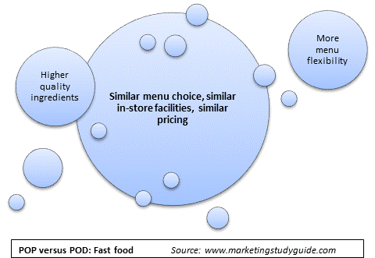
In this example let’s assume that the market leader is McDonald’s. The center circle in the diagram highlights the points-of-parity that the rival chain wants to duplicate. However, the rival firm chain still needs to give consumers a reason to switch, so they have identified two points-of-difference to highlight as part of their overall positioning

Slide 33
Example 2: Small education provider, who offers an alternative to a large university program. Again the large central circle highlights the points-of-parity. The points-of-difference (as highlighted in the outside circles) indicate that this particular college/school has decided to emphasize three major differentiating benefits.

Slide 34
Updating Positioning over time
Updating positioning raises two main issues:
Laddering – how the brand meaning is further deepened in the minds of the consumers.
Reacting – how due to competitive action a brand is forced to react as it loses its POD.

Slide 35
LADDERING
A means-end chain has been devised as a way of understanding higher level meanings of the brand
Attributes (descriptive features that characterize a product)
Benefit (the personal benefit and meaning attached to product attributes)
Personal values signify the need that the benefit address

Slide 36
REACTING
Do nothing: If competitor brand is unlikely to create a sustainable POD because they do not have the resources. Continue brand building process.
Go on the defensive: Further invest in strengthening POP and POD if competitors is trying to disrupt your POD. DEFEND your positioning. Example: Magic continuously defends its positioning.
Go on the offensive: completely change the positioning of the brand …very risky for established brands.

Slide 37
Brand Mantra
A brand mantra is a 3-5 word shorthand encapsulation of your brand position. It is not an advertising slogan, and, in most cases, it won’t be something you use publicly.
Federal Express: “Peace of mind”
Nike: “Authentic athletic performance”
Target: “Democratize design”
Mary Kay: “Enriching women’s lives”

Slide 38
NIKE’S Brand Mantra
According to Scott Bedbury (author of A New Brand World, one the of top 10 books behind Dark Matter Matters):
Nike’s brand mantra put a particular emphasis on maintaining authenticity, by which we also meant integrity and purity, front and center… All products and activities associated with Nike likewise had to be athletic, not leisurely… Finally, every Nike product had to exude world-class performance and meet the demands of the world’s finest athletes, even though such athletes represented a microscopic piece of Nike’s total business… “Authentic Athletic Performance” was a simple idea, but like so many simple ideas, its execution and implementation could be complex, not to mention challenging, daunting, — and even painful, when it came down to forgoing revenue-generating activities because they violated these accepted core values

Slide 39
Three parameters of Brand Mantra
Brand function (what?) describes the nature of the product/service and the benefits the brand provides.
Descriptive modifier (whom?) clarifies the core target customers.
Emotional modifier (how?) how exactly the brand provides the benefits and in what ways?

