Slide 1
DESIGNING MARKETING PROGRAMS TO BUILD BRAND EQUITY

Slide 2
New perspectives on marketing

Slide 3
New perspectives on marketing
The four major drivers of this new economy are:
Digitalization and connectivity (internet, intranet, mobile devices)
Disintermediation and reintermediation (middlemen)
Customization and customerization (tailored products and ingredients provided to customers to make their own products)
Industry convergence (blurring of industry boundaries)

Slide 4
Integrating Marketing Programs and Activities
Creative and original thinking is necessary to create fresh new marketing programs that break through the noise in the marketplace to connect with customers.
Marketers are increasingly trying a host of unconventional means of building brand equity.

Slide 5
Personalized Marketing
All of these approaches are a means to create deeper, richer, and more favorable brand associations.
Relationship marketing has become a powerful brand-building force.
Can slip through consumer radar
May creatively create unique associations
May reinforce brand imagery and feelings
Nevertheless, there is still a need for the control and predictability of traditional marketing activities.
Models of brand equity can help to provide direction and focus to the marketing programs.

Slide 6
Personalized Marketing: A Missed Opportunity?
To get an idea of how big a missed opportunity this is, take a look at these stats:
Businesses that personalize web experiences see an average 19% increase in sales. (MarketingProfs)
71% of companies fail to personalize their websites. (Dynamic Yield)
Personalized marketing emails receive 29% higher open rates and 41% higher click-through rates. (Experian)
70% of companies don’t personalize marketing emails. (Experian)

Slide 7
Personalized Marketing Concepts
Experiential marketing
One-to-one marketing
Permission marketing

Slide 8
Experiential Marketing
Focuses on customer experience
Focuses on the consumption situation
Views customers as rational and emotional elements
Uses electric methods and tools

Slide 9
Experiential Marketing
Running from mid July to early September the ‘Samsung Studios’ focused on demonstrating the new Galaxy S3 and Galaxy Note.
Visitors could play with Samsung’s Olympic Games app or have their photo taken on the Galaxy S3 and instantly turned into a personalised badge.

Slide 10
Experiential Marketing
Doc McStuffin is a Disney Channel TV show about a six-year-old girl who heals toys out of her imaginary clinic.
To promote the upcoming second series and increase merchandise sales Disney recreated Doc’s clinic in Tesco, Smyths and Toys R Us in the UK.
Children were given a 10-minute immersive experience where they took the role of Doc and diagnosed what was wrong with Big Ted.
Children waiting for their turn were able to play with Doc McStuffin merchandise, do colouring in, or watch clips from the TV show.

Slide 11
One-to-One Marketing
Competitive Rationale
Consumer Differentiation
Consumers help to add value by providing information.
Firm adds value by generating rewarding experiences with consumers.
Creates switching costs for consumers
Reduces transaction costs for consumers
Maximizes utility for consumers
Treat different consumers differently
Different needs
Different values to firm
Current
Future (lifetime value)

Slide 12
One-to-One Marketing: Five Key Steps
Identify consumers, individually
Differentiate them by value and needs
Interact with them more cost-efficiently and effectively
Customize some aspect of the firm’s behavior
Brand the relationship

Slide 13
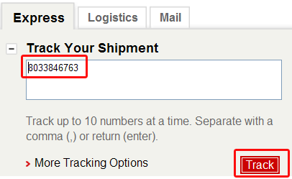

Slide 14
Permission Marketing (Seth Godin)
According to Seth Godin (who coined the term), “permission marketing is the privilege (not the right) of delivering anticipated, personal, and relevant messages to people who actually want them.”
Those who want messages sign up, subscribe, or otherwise opt-in to particular message mediums, such as newsletters or short message services (SMS).
Permission marketing can be contrasted to interruption marketing.

Slide 15
Five Steps in Permission Marketing
Offer the prospect an incentive to volunteer.
Offer the interested prospect a curriculum over time, teaching consumers about the product.
Reinforce the incentive to guarantee that prospect maintains the permission.
Offer additional incentives to get more permission from the consumer.
Over time, leverage the permission to change consumer behavior toward profits.

Slide 16
Integrating the Brand Into Supporting Marketing Programs
Supporting marketing mix should be designed to enhance awareness and establish desired brand image.
Product strategy
Pricing strategy
Channel strategy

Slide 17
Product Strategy
Perceived quality and value
Brand intangibles
Total quality management and return on quality
Value chain
Relationship marketing
Mass customization
After-marketing
Loyalty programs

Slide 18
Product Strategy: Mass Customization

Slide 19
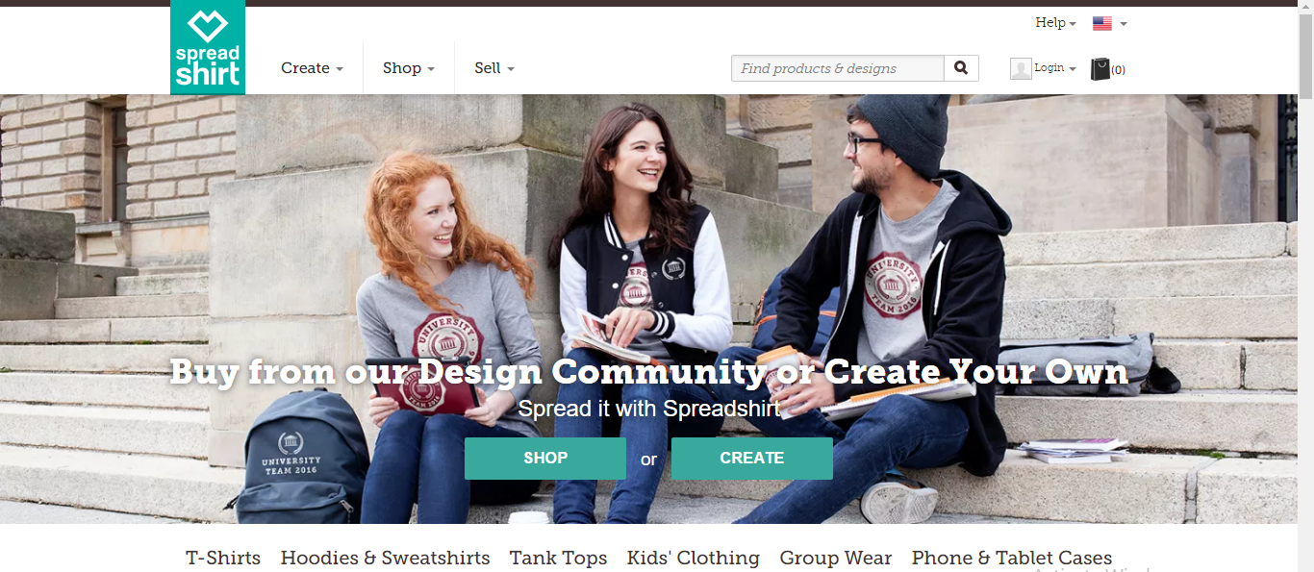
Product Strategy: Mass Customization
1. Collaborative Customization - Collaborative customizers talk to the clients to help them recognize what they need, to recognize factors that will fulfill those needs and to create customized products following those guidelines.

Slide 20
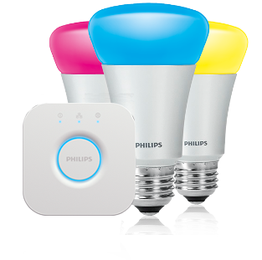
Product Strategy: Mass Customization
2. Adaptive Customization - Businesses that follow the approach of adaptive customization offer one standard product to the customers along with a few customization options. This approach makes sure that the product is designed in a manner that it can be customized by the end client with absolute ease.

Slide 21
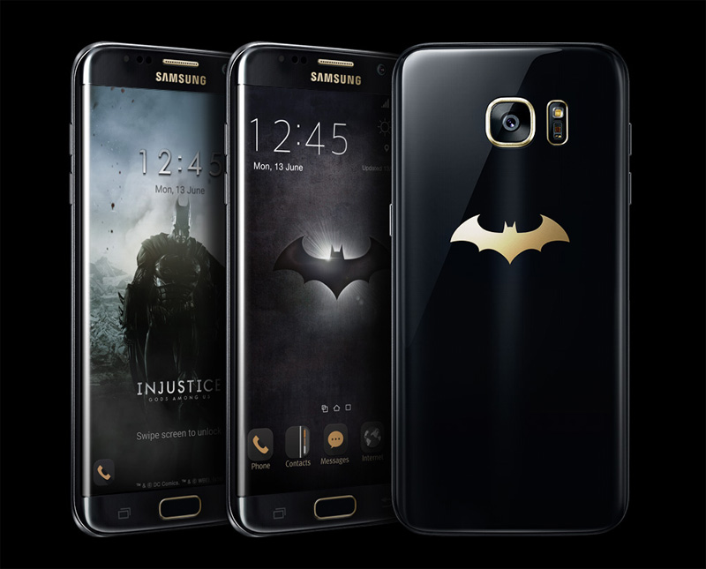
Product Strategy: Mass Customization
3. Cosmetic Customization - Cosmetic customizers advertise a standard product differently to different groups of clients. This approach works well when clients use the same product but want them to be presented differently. Such products are not customized but instead they are packaged differently to suit different kinds of customers.

Slide 22
Product Strategy: Mass Customization
4. Transparent Customization - Transparent Customization deals with providing customized products to individual clients without telling them that the products are exclusively produced for them.
This approach work in cases where the customer does not want to repeat what she/he needs incessantly or when client needs are predictable or obvious.

Slide 23
Pricing Strategy
Price premiums are among the most important brand equity benefits of building a strong brand.
Consumer price perceptions
Consumers often rank brands according to price tiers in a category.
Setting prices to build brand equity
Value pricing
Everyday low pricing

Slide 24
Channel Strategy
The manner by which a product is sold or distributed can have a profound impact on the resulting equity and ultimate sales success of a brand.
Channel strategy includes the design and management of intermediaries such as wholesalers, distributors, brokers, and retailers.

Slide 25
Channel Strategy: Channel Design
Direct channels: Selling through personal contacts from the company to prospective customers by mail, phone, electronic means, in-person visits, and so forth.
Indirect channels: Selling through third-party intermediaries such as agents or broker representatives, wholesalers or distributors, and retailers or dealers
Push and pull strategies
Web strategies

Slide 26
Push and Pull Strategies
By devoting marketing efforts to the end consumer, a manufacturer is said to employ a pull strategy.
Alternatively, marketers can devote their selling efforts to the channel members themselves, providing direct incentives for them to stock and sell products to the end consumer. This approach is called a push strategy.

Slide 27
Web Strategies
Advantage of having both a physical “brick and mortar” channel and a virtual, online retail channel
The Boston Consulting Group concluded that multichannel retailers were able to acquire customers at half the cost of Internet-only retailers, citing a number of advantages for the multichannel retailers.

Slide 28
Integrating Product, Pricing, and Channel
We build quality kitchen hardware for residential kitchen customers.
Our customers are young North American families who want kitchen hardware that can stand the wear and tear of young children. They are interested in materials that are safe for children and eco-friendly.
We sell our products through a retail channel.
Our products are priced per unit, and are considered “high-end” hardware solutions.

