Slide 1
Integrating Marketing Communications to Build Brand Equity

Slide 2
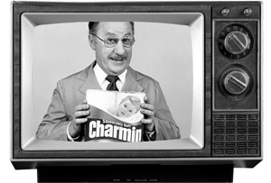
The New Media Environment
Traditional advertising media such as TV, radio, magazines, and newspapers seem to be losing their grip on consumers.
Marketers pour billions into Internet advertising. While Web advertising jumped during this time, spending for TV ads remained flat.

Slide 3
The New Media Environment (cont.)
Marketing communications can contribute to brand equity in a number of different ways:
By creating awareness of the brand
Linking POP and POD associations to the brand in the consumers’ memory
Eliciting positive brand judgment
Facilitating a stronger consumer-brand connection and brand resonance

Slide 4
FIG 6.2: Simple Test for Marketing Communications
Current
Brand
Knowledge
Desired
Brand
Knowledge
What is your current Brand Knowledge? Have you created a detailed mental map?
What is your desired Brank Knowledge? Have you defined optimal POP and POD and a brand mantra.
How does the communication option help the brand get from current to desired knowledge with consumers. Have you clarified the specific effects on knowledge engendered by communications?

Slide 5
Integrated Marketing Communications (IMC)
The “voice” of the brand
A means by which it can establish a dialogue and build relationships with consumers
Allow marketers to inform, persuade, provide incentives, and remind consumers directly or indirectly
Can contribute to brand equity by establishing the brand in memory and linking strong, favorable, and unique associations to it

Slide 6
Information Processing Model of Communications
Exposure – a person must see or hear the communication
Attention – a person must notice the communication
Comprehension – a person must understand the intended message of the communication
Yielding – a person must respond favorably to the intended message of the communication
Intentions – a person must plan to act in the desired manner of the communication
Behavior – a person must actually act in the desired manner of the communication

Slide 7
Marketing Communications Options
Advertising
Promotions
Event marketing and sponsorship
Public relations and publicity
Personal selling

Slide 8
Advertising
A powerful means of creating strong, favorable, and unique brand associations and eliciting positive judgments and feelings
Controversial because its specific effects are often difficult to quantify and predict
Nevertheless, a number of studies using very different approaches have shown the potential power of advertising on brand sales.

Slide 9
Ideal Ad Campaign
The ideal ad campaign would ensure that:
The right consumer is exposed to the right message at the right place and at the right time.
The creative strategy for the advertising causes the consumer to notice and attend to the ad but does not distract from the intended message.
The ad properly reflects the consumer’s level of understanding about the product and the brand.
The ad correctly positions the brand in terms of desirable and deliverable points-of-difference and points-of-parity.
The ad motivates consumers to consider purchase of the brand.
The ad creates strong brand associations to all of these stored communication effects so that they can have an effect when consumers are considering making a purchase.

Slide 10
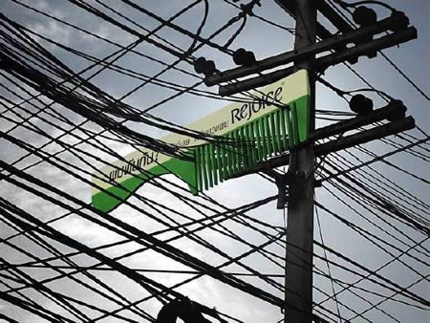
Creative Advertisement

Slide 11
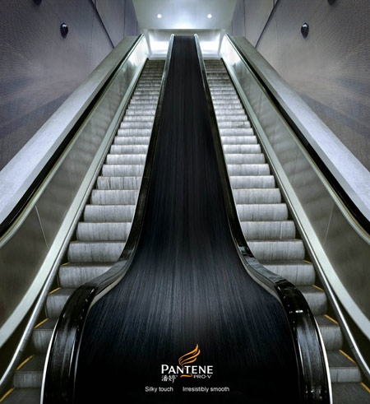

Slide 12
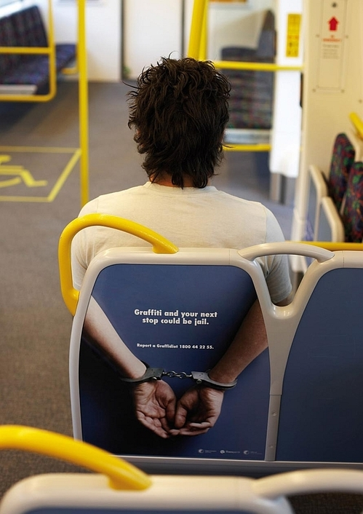

Slide 14
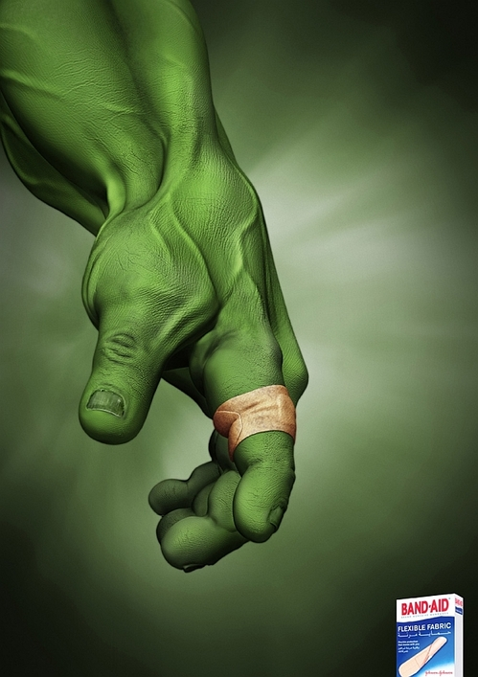

Slide 16
Promotions
Short-term incentives to encourage trial or usage of a product or service
Marketers can target sales promotions at either the trade or end consumers
Consumer promotions
Consumer promotions are designed to change the choices, quantity, or timing of consumers’ product purchases. (Tresemme shampoo at checkout)
Trade promotions
Trade promotions are often financial incentives or discounts given to retailers, distributors, and other members of the trade to stock, display, and in other ways facilitate the sale of a product. (B&H free samples to retailers; Dhaka Trade Fair)

Slide 19
Event Marketing and Sponsorship
Event marketing is public sponsorship of events or activities related to sports, art, entertainment, or social causes.
Event sponsorship provides a different kind of communication option for marketers. By becoming part of a special and personally relevant moment in consumers’ lives, sponsors can broaden and deepen their relationship with their target market.

Slide 20
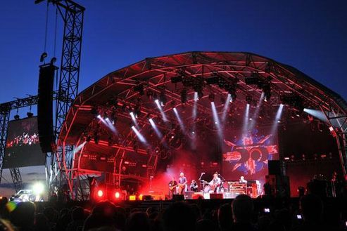

Slide 21
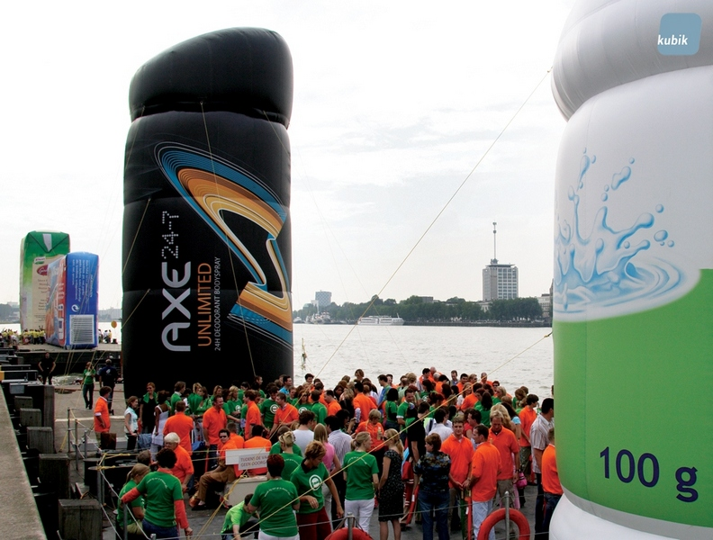

Slide 22
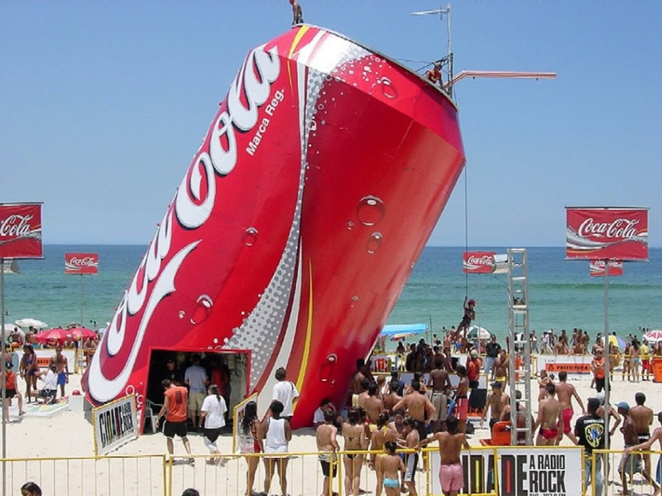

Slide 23
Public Relations and Publicity
Public relations and publicity relate to a variety of programs and are designed to promote or protect a company’s image or its individual products.
Buzz Marketing
Occasionally, a product enters the market with little fanfare yet is still able to attract a strong customer base.

Slide 24
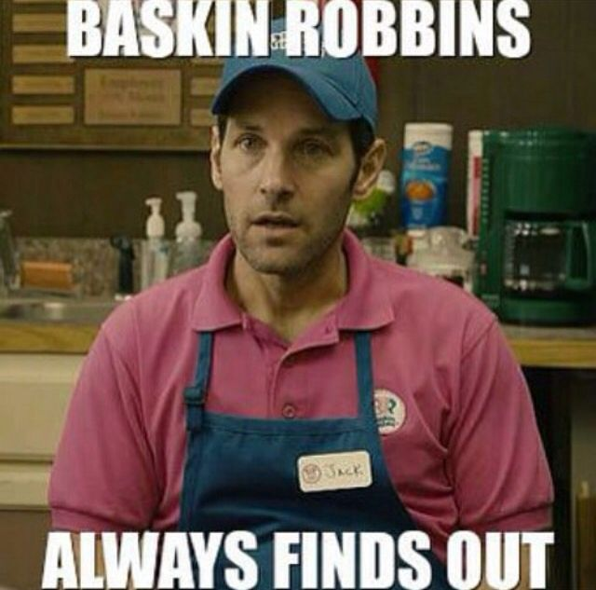

Slide 25
Personal Selling
Personal selling is face-to-face interaction with one or more prospective purchasers for the purpose of making sales
The keys to better selling
Rethink training
Get everyone involved
Inspire from the top
Change the motivation
Forge electronic links
Talk to your customers

Slide 26
Developing IMC Programs
Mixing communication options
Evaluate all possible communication options available to create knowledge structures according to effectiveness criteria as well as cost considerations.
Different communication options have different strengths and can accomplish different objectives.
Determine the optimal mix

Slide 27
Evaluating IMC Programs
Coverage: What proportion of the target audience is reached by each communication option employed? How much overlap exists among options?
Cost: What is the per capita expense?
Contribution: The collective effect on brand equity in terms of
enhancing depth and breadth of awareness
improving strength, favorability, and uniqueness of brand associations
Commonality: The extent to which information conveyed by different communication options share meaning

Slide 28
Evaluating IMC Programs (cont.)
Complementarity: The extent to which different associations and linkages are emphasized across communication options
Versatility: The extent to which information contained in a communication option works with different types of consumers
Different communications history
Different market segments

Slide 29
IMC Audience Communication Option Overlap
Communication
Option A
Communication
Option B
Audience
Communication Option C
Note: Circles represent the market segments reached by various communication options.
Shaded portions represent areas of overlap in communication options.

Slide 30
Marketing Communication Guidelines
Be analytical: Use frameworks of consumer behavior and managerial decision making to develop well-reasoned communication programs
Be curious: Fully understand consumers by using all forms of research and always be thinking of how you can create added value for consumers
Be single-minded: Focus message on well-defined target markets (less can be more)
Be integrative: Reinforce your message through consistency and cuing across all communications

Slide 31
Marketing Communication Guidelines (Cont.)
Be creative: State your message in a unique fashion; use alternative promotions and media to create favorable, strong, and unique brand associations
Be observant: Monitor competition, customers, channel members, and employees through tracking studies
Be realistic: Understand the complexities involved in marketing communications
Be patient: Take a long-term view of communication effectiveness to build and manage brand equity

Slide 32
