Slide 1
LEVERAGING SECONDARY BRAND ASSOCIATIONS TO BUILD EQUITY

Slide 2
Building Customer-Based Brand Equity
BRAND BUILDING TOOLS CONSUMER KNOWLEDGE EFFECTS BRANDING BENEFITS
Choosing Brand Elements
Brand name Memorability
Logo Meaningfulness
Symbol Appeal
Character Transferability
Packaging Adaptability
Slogan Protectability
Brand Awareness
Depth
Breadth
Possible Outcomes
Greater loyalty
Less vulnerability to competitive marketing actions and crises
Larger margins
More inelastic response to price
Greater trade cooperation and support
Increased marketing communication efficiency and effectiveness
Possible licensing opportunities
More favorable brand extension evaluations
Recall
Recognition
Purchase
Consumption
Developing Marketing Programs
Product Tangible and intangible benefits
Price Value perceptions
Distribution channels Integrate”push” and “pull”
Communications Mix and match options
Brand Associations
Strong
Favorable
Unique
Relevance
Consistency
Desirable
Deliverable
Point-of-parity
Point-of-difference
Leverage of Secondary Associations
Company
Country of origin
Channel of distribution
Other brands
Endorsor
Event
Awareness
Meaningfulness
Transferability

Slide 3
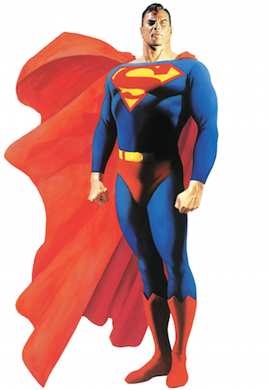

Slide 4
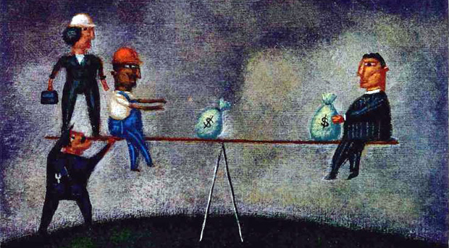

Slide 5
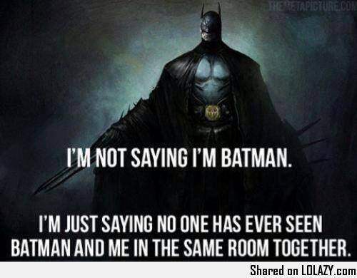
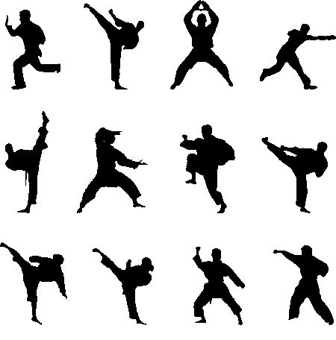
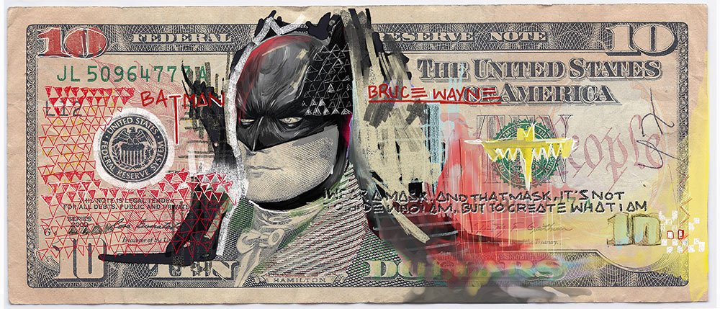

Slide 6
Leveraging Secondary Brand Associations
“Borrowing” some brand knowledge and depending on the nature of associations or responses, some brand equity
Unlike brand elements and communication strategies, this is an indirect approach to build brand equity

Slide 7
Leveraging Secondary Brand Associations
Brand associations may themselves be linked to other entities, creating secondary associations:
Company (through branding strategies)
Country of origin (through identification of product origin)
Channels of distribution (through channels strategy)
Other brands (through co-branding)
Special case of co-branding is ingredient branding
Characters (through licensing)
Celebrity spokesperson (through endorsement advertising)
Events (through sponsorship)
Other third-party sources (through awards and reviews)

Slide 8
Brand Associations through: COMPANY

Slide 9
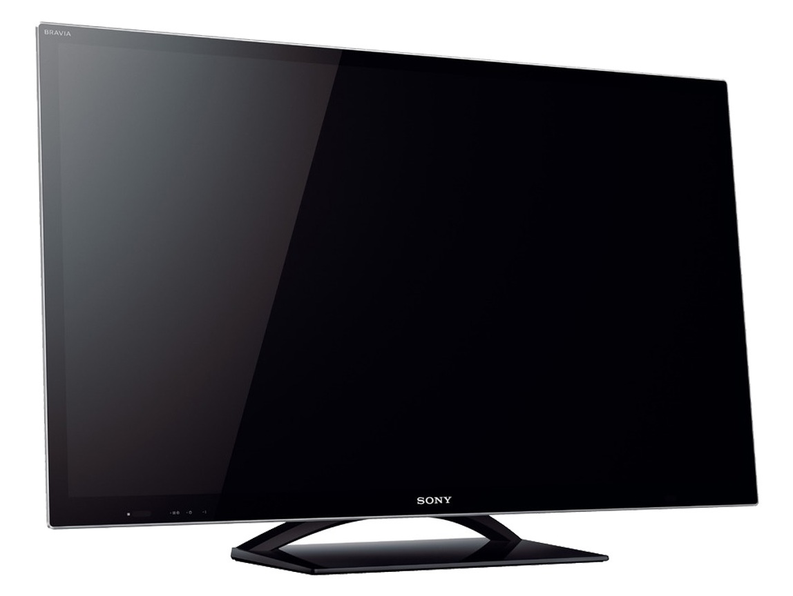
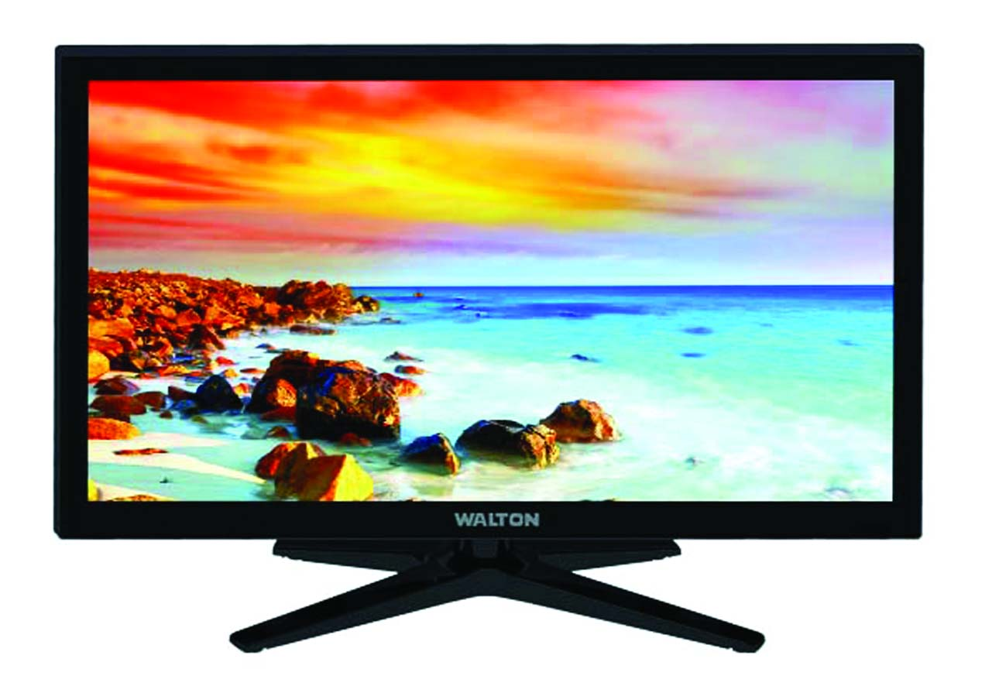
Brand Associations through: COUNTRY OF ORIGIN

Slide 10
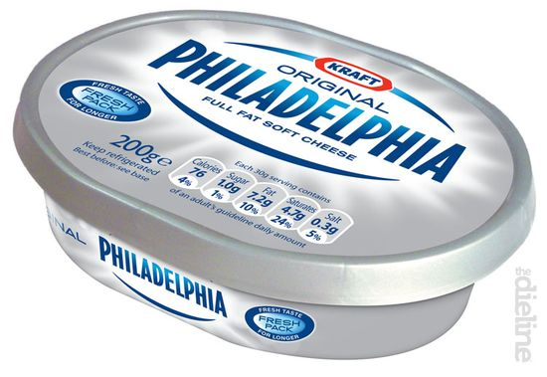
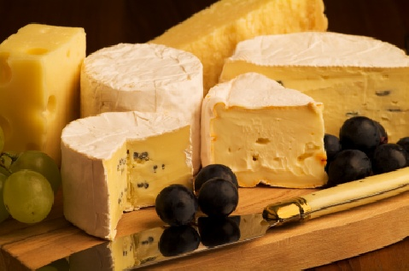
Brand Associations through: COUNTRY OF ORIGIN

Slide 11
Brand Associations through: CHANNELS OF DISTRIBUTION
Associations with:
Product
Price
Credit Policy
Quality of Service
Results in associations of brands by retailers

Slide 12
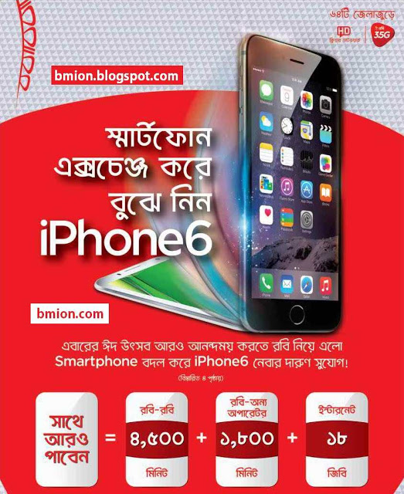
Brand Associations through: CHANNELS OF DISTRIBUTION

Slide 13
Brand Associations through: CO-BRANDING
Occurs when two or more existing brands are combined into a joint product or are marketed together in some fashion
Guidelines to Co-branding:
Both brand should have equal awareness
Sufficiently strong
Favorable
Unique associations
Positive consumer judgments and feelings

Slide 14
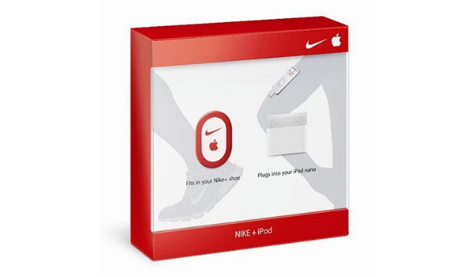
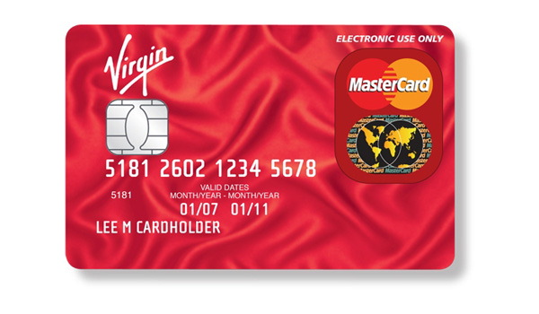
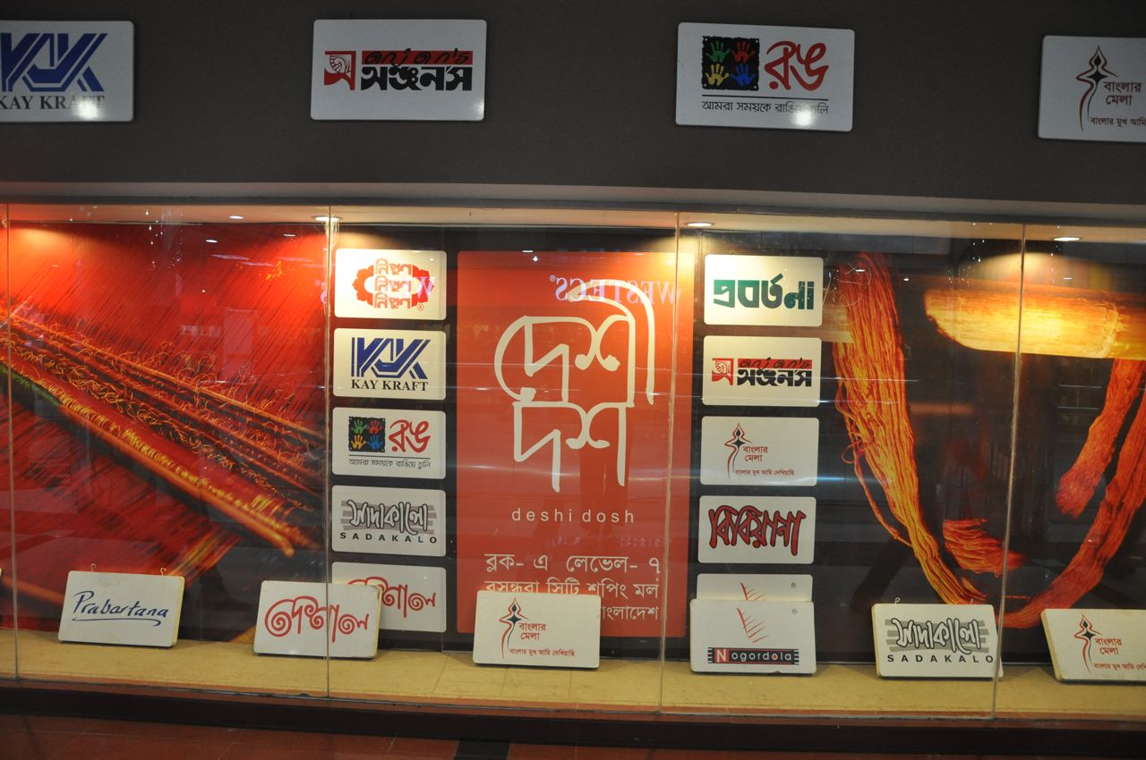
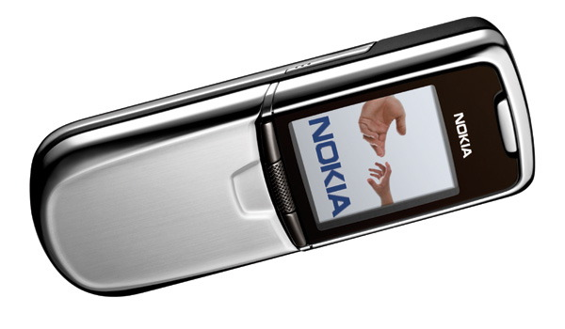

Slide 15
Brand Associations through: CO-BRANDING
Advantages of Co-Branding
Borrow needed expertise
Leverage equity you don’t have
Reduce cost of product introduction
Expand brand meaning into related categories
Broaden meaning
Increase access points
Source of additional revenue

Slide 16
Brand Associations through: CO-BRANDING
Disadvantages of Co-Branding
Loss of control
Risk of brand equity dilution
Negative feedback effects
Lack of brand focus and clarity
Organizational distractions

Slide 17
Brand Associations through: CO-BRANDING (INGREDIENT BRANDING)
A special case of co-branding that involves creating brand equity for materials, components, or parts that are necessarily contained within other branded products

Slide 18
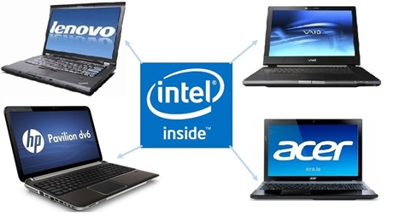
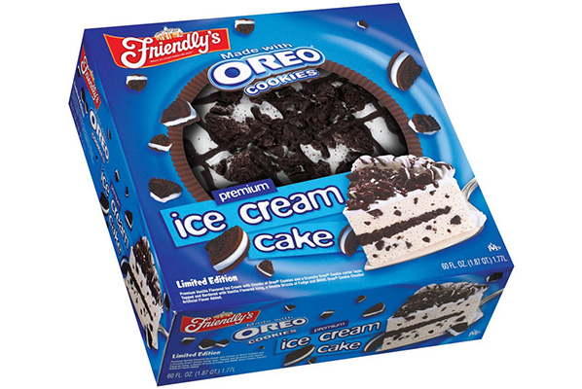

Slide 19
Brand Associations through: LICENSING
Involves contractual arrangements whereby firms can use the names, logos, characters, and so forth of other brands for some fixed fee
Guidelines for Licensing
Don’t get caught up, one minute they are in next minute they are gone
Multiple license agreements results in over exposure and wearing out quickly
If your brand gets over exposed, either you will close or you will sell

Slide 20
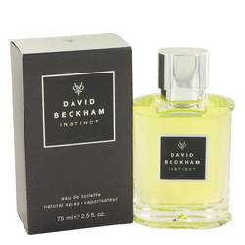

Slide 22
Brand Associations through: CELEBRITY ENDORSEMENT
Draws attention to the brand
Shapes the perceptions of the brand
Celebrity should have a high level of visibility and a rich set of useful associations, judgments, and feelings
Q-Ratings to evaluate celebrities (a scale measuring the popularity of a person or thing typically based on dividing an assessment of familiarity by an assessment of favorable opinion)

Slide 23
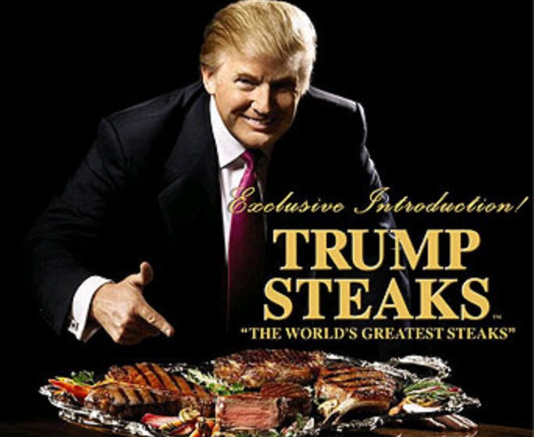

Slide 24
Brand Associations through: CELEBRITY ENDORSEMENT
Potential Problems
Celebrity endorsers can be overused by endorsing many products that are too varied.
There must be a reasonable match between the celebrity and the product.
Celebrity endorsers can get in trouble or lose popularity.
Many consumers feel that celebrities are doing the endorsement for money and do not necessarily believe in the endorsed brand.
Celebrities may distract attention from the brand.

Slide 25
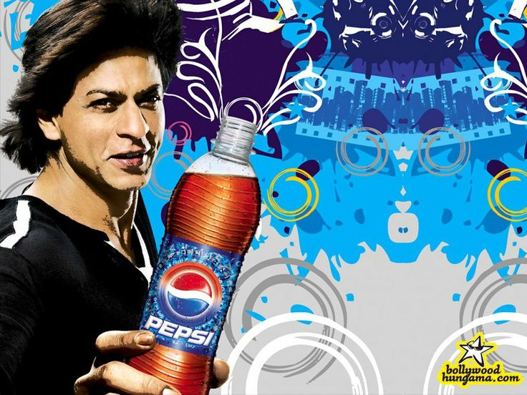
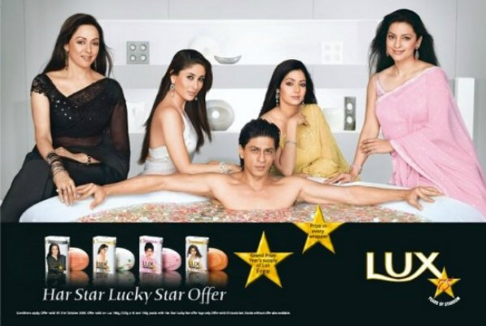
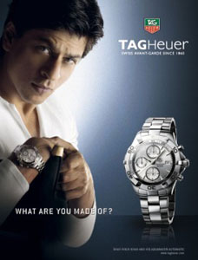
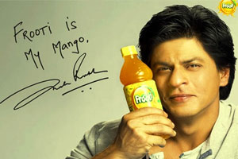

Slide 26
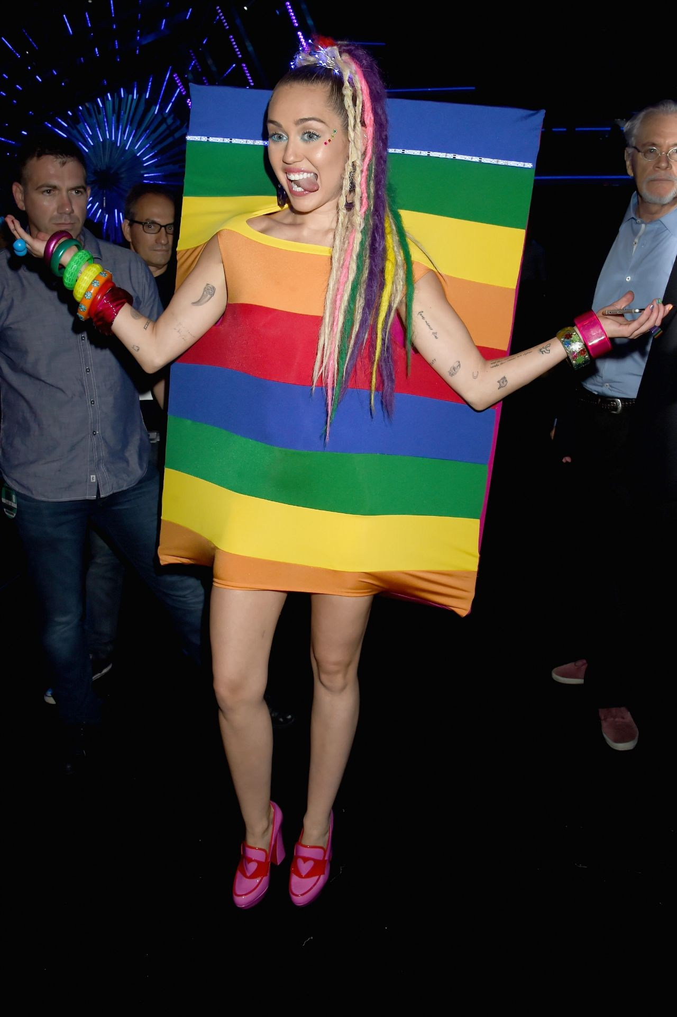
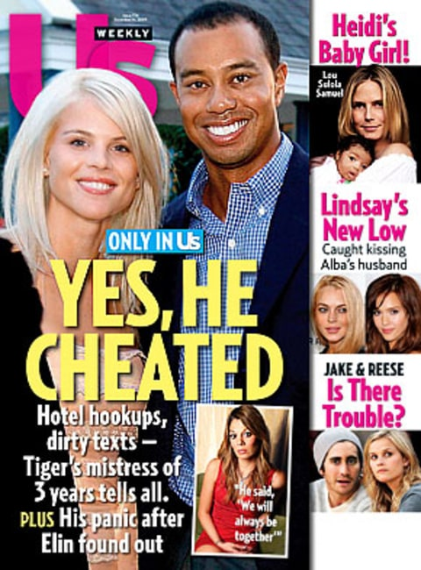

Slide 27
Brand Associations through: SPORTING, CULTURAL, OR OTHER EVENTS
Sponsored events can contribute to brand equity by becoming associated to the brand and improving brand awareness, adding new associations, or improving the strength, favorability, and uniqueness of existing associations.
The main means by which an event can transfer associations is credibility.

Slide 28
Brand Associations through: SPORTING, CULTURAL, OR OTHER EVENTS
GUIDELINES
Use popular events with a loyal following to create links and associations.
The equity of the event will be rubbed off on the brand that is sponsoring it.
Just sponsoring will not mean a lot to the participants/customers, instead the brand needs to create an opportunity for the brand to interact with the participants and also create a brand experience.
When budgeting for an event sponsorship allocate a separate budget to promote the event via ATL & BTL media and also for activations and give away's.

Slide 29
Brand Associations through: THIRD-PARTY SOURCES
Marketers can create secondary associations in a number of different ways by linking the brand to various third-party sources.
Third-party sources can be especially credible sources.
Marketers often feature them in advertising campaigns and selling efforts .
Example: J.D. Power and Associates’ well-publicized Customer Satisfaction Index

