Slide 1
Designing & Implementing Brand Architecture Strategies

Slide 2
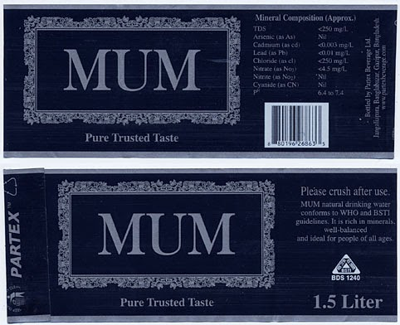

Slide 4
Brand Architecture
Brand Strategy or Brand Architecture for a firm tells marketers which brand name, logos, symbols and so forth to apply to new and existing products
We often distinguish branding strategies by whether a firm is or should be employing an umbrella corporate or family brand for all its products (As a branded house) or a collection of individual brands all with different names (House of brands)
Defines both the brand boundaries and brand complexity.
Which different products should share the same brand name?
How many variations of that brand name should we employ?

Slide 5
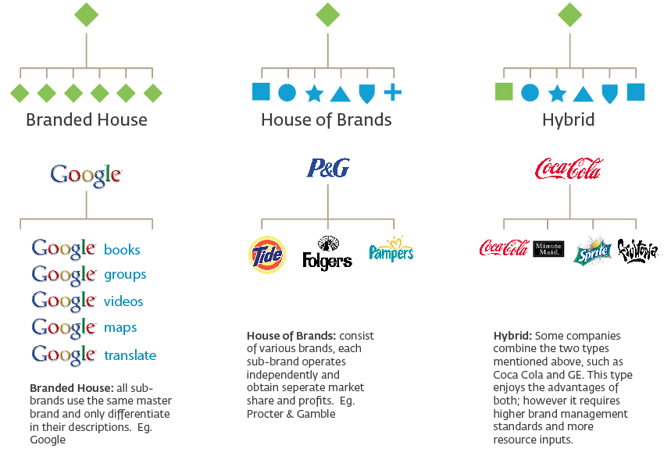

Slide 7
Brand Architecture
The role of defining branding strategies and brand architecture is two fold:
Clarify – Brand Awareness: Improve the customers understanding and communicate the similarities and differences between individual products
Motivate – Brand Image: Maximize transfer of equity to/from the brand to individual products to improve trial and repeat purchase

Slide 8
The Brand–Product Matrix
Products
Must define:
Brand-Product relationships (rows)
Line and category extensions
Product-Brand relationships (columns)
Brand portfolio
1
2
3
4
A
Brands
B
C
Notes:
71

Slide 9
The Brand–Product Matrix
The matrix has the brands of the firm as rows and the corresponding products as columns
The rows of the matrix represent the brand-product relationships and capture the brand extension strategies (Line Extension & Category Extension) of the firm in terms of number and nature of the products sold under the firms different brands
The columns of the matrix represent the brand portfolio strategy in terms of the number and nature of the brands to be marketed in each category.

Slide 10
The Brand–Product Matrix
A product line is a group of products within a product category that are closely related because they function in a similar manner, are sold to the same customer groups, are marketed through the same type of outlets, or fall within given price ranges
A product line may include different brands, or a single family brand or individual brand that has been line extended.
A product mix is a set of all product lines and items that a particular seller makes available to buyers. Thus product lines represent different sets of columns in the brand – product matrix that in total make up the product mix
A brand mix (brand portfolio) is the set of brand lines that a particular seller makes available to buyers

Slide 11
Breadth of a Branding Strategy
Being broad in scope.
Carrying items in many different product categories.
Offering several different types of service under one roof.
This means that you try to offer everything a customer might want, even if it’s only remotely related to your product or service offering.

Slide 14
Depth of Branding Strategy
This is the number and nature of different brands marketed in the product class sold by a firm.
Why does a firm have multiple brands in the same product category?
Market coverage
Pursue different price segments, different channels of distribution, different geographic boundaries etc.
To create internal competition within the firm
To attract consumers seeking variety who may switch
To yield economies of scale in terms of merchandising, sales, advertising
Poorly differentiated brands can also result in cannibalization
Brands portfolio should cover all major market segments however minimize brand overlay

Slide 15
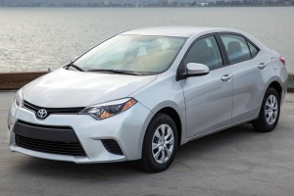
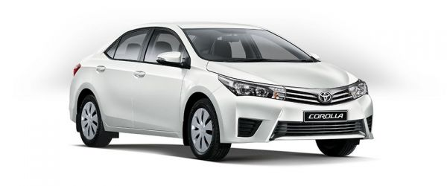
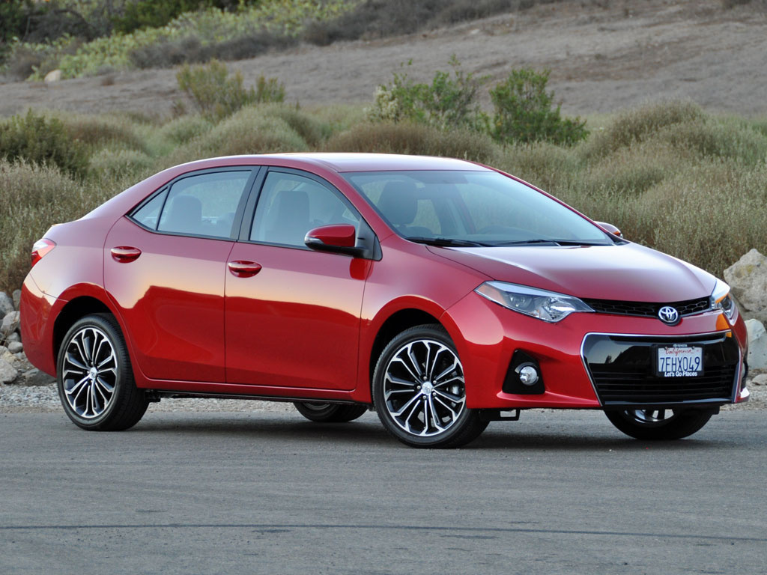

Slide 16
Designing a Brand Portfolio
Basic principles:
Maximize market coverage so that no potential customers are being ignored
Minimize brand overlap so that brands aren’t competing among themselves to gain the same customer’s approval

Slide 17
Brand Roles in the Portfolio
Flankers
Cash cows
Low-end entry-level
High-end prestige brands

Slide 18
Flankers or Fighters
A flanker brand is a new brand introduced into the market by a company that already has an established brand in the same product category.
The new brand is designed to compete in the category without damaging the existing item’s market share by targeting a different group of consumers.

Slide 19
Flankers or Fighters
These are protective brands with lesser profit margins
These brands build strong points of parity with competing brands so that stronger brands can sustain their positioning
Many firms are introducing discount brands as flankers to better compete with store brands or private labels and protect the high priced brand companions.
Some firms are repositioning existing brands in their portfolio to play that role
Fighter brands must not be so attractive that they take the sales away from their higher priced comparison brands
At the same time if fighter brands are connected to other brands in the portfolio in ANY way, they must not be designed so cheaply that they reflect poorly on these other brands

Slide 20
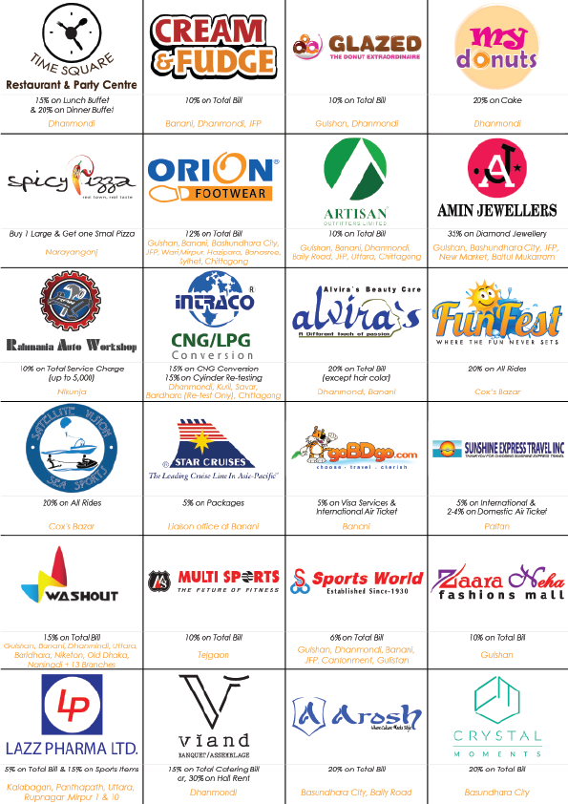

Slide 21
Cash Cows
Sales may be decreasing however still have a considerable share
Market is not growing, new products/brands are cannibalizing
i.e. Gillette still sells its older Trac 2, Atra and Sensor brands because withdrawing these brands may not result in consumers upgrading and also these brands still have a considerable sales volume to support the brand

Slide 22
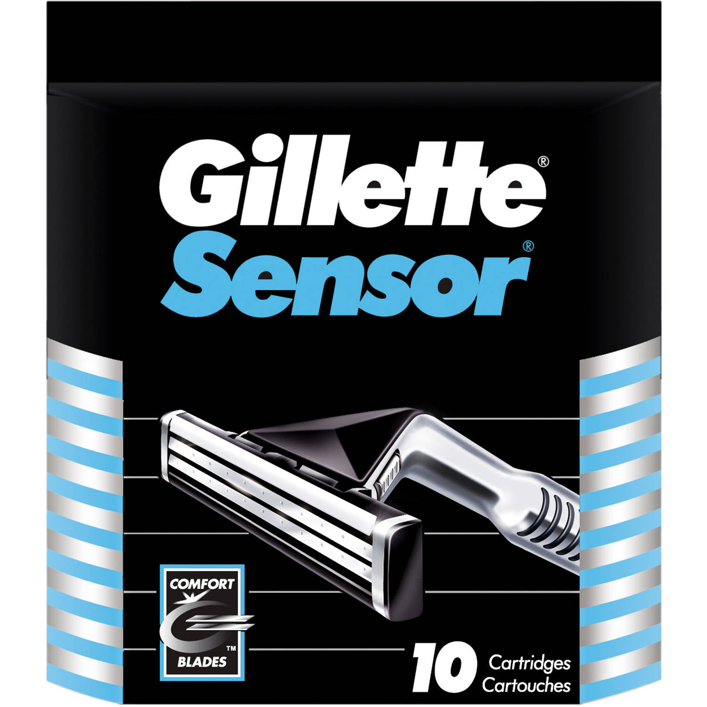

Slide 23
Low-End, Entry–Level or High-End Prestige Brands
Low-End/Entry Level brands are generally traffic builders
They are not meant to be significantly profitable
These brands reel in potential customers into the brand franchise
These brands are the stepping stone to attract customers
High end brands ensures maximum Customer Lifetime Value (CLV) by giving the option for customers to upgrade

Slide 24
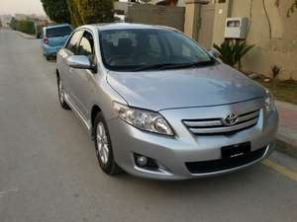
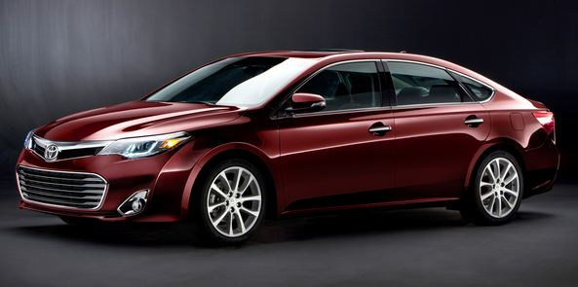

Slide 26
Brand Hierarchy
A means of summarizing the branding strategy by displaying the number and nature of common and distinctive brand elements across the firm’s products, revealing the explicit ordering of brand elements
A useful means of graphically portraying a firm’s branding strategy

Slide 27
Brand Hierarchy Tree: Toyota
Toyota
Corporation
Toyota
(Trucks)
Toyota
(SUV/vans)
Toyota
(Cars)
Toyota
Financial
Services
Lexus
Corolla
MR2
Spyder
Camry
Avalon
Celica
ECHO
Matrix
Prius
Platinum
Edition
XL
XLS
CE
S
LE
SE
LE
XLE
SE
SLE

Slide 28
NIVEA
Personal Care
Face care/Cosmetics
Skin Care
NIVEA Crème
NIVEA Body
NIVEA Hand
NIVEA Visage
NIVEA Vital
Nivea Beautè
NIVEA Deo
NIVEA Bath Care
NIVEA Hair Care
NIVEA Lipcare
NIVEA For Men
NIVEA Sun
NIVEA Baby

Slide 29
Brand Hierarchy Levels
Corporate Brand (General Motors)
Family Brand (Pran)
Individual Brand (Park Avenue)
Modifier: Item or Model (Ultra)
Notes:
65

Slide 30
Corporate Brand
Corporate branding is the practice of using a company's name as a product brand name. It is an attempt to use corporate brand equity to create brand recognition.
Example - IBM, Heinz, Hershey, Coca-Cola, etc….

Slide 31
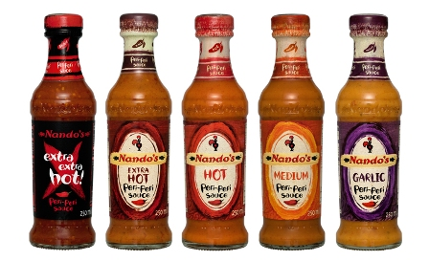

Slide 32
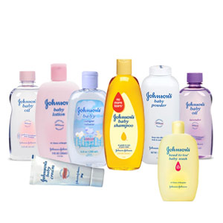

Slide 33
Family Brands
When a group of products are given the same brand name i.e. different products of company are marketed under one brand name.
Company level associations are less salient
The cost of launching new products can be reduced through family branding
The failure of one product may have adverse effects on the family brand
The pro’s and con’s will determine whether a “Branded house” or a “House of brands” is the more appropriate strategy

Slide 34
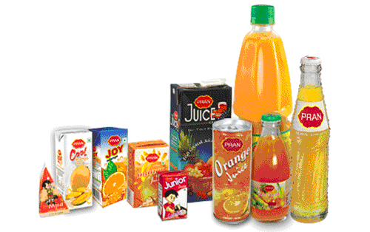

Slide 35
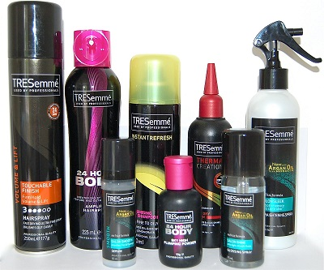

Slide 36
Individual Brands
Individual branding, also called individual product branding or multi branding. It is the marketing strategy of giving each product in a portfolio its own unique brand name.
The advantage of individual branding is that each product has an image and identity that is unique.
The disadvantage are difficulty, complexity & expense involved in developing separate marketing programs to build sufficient levels of brand equity.

Slide 37
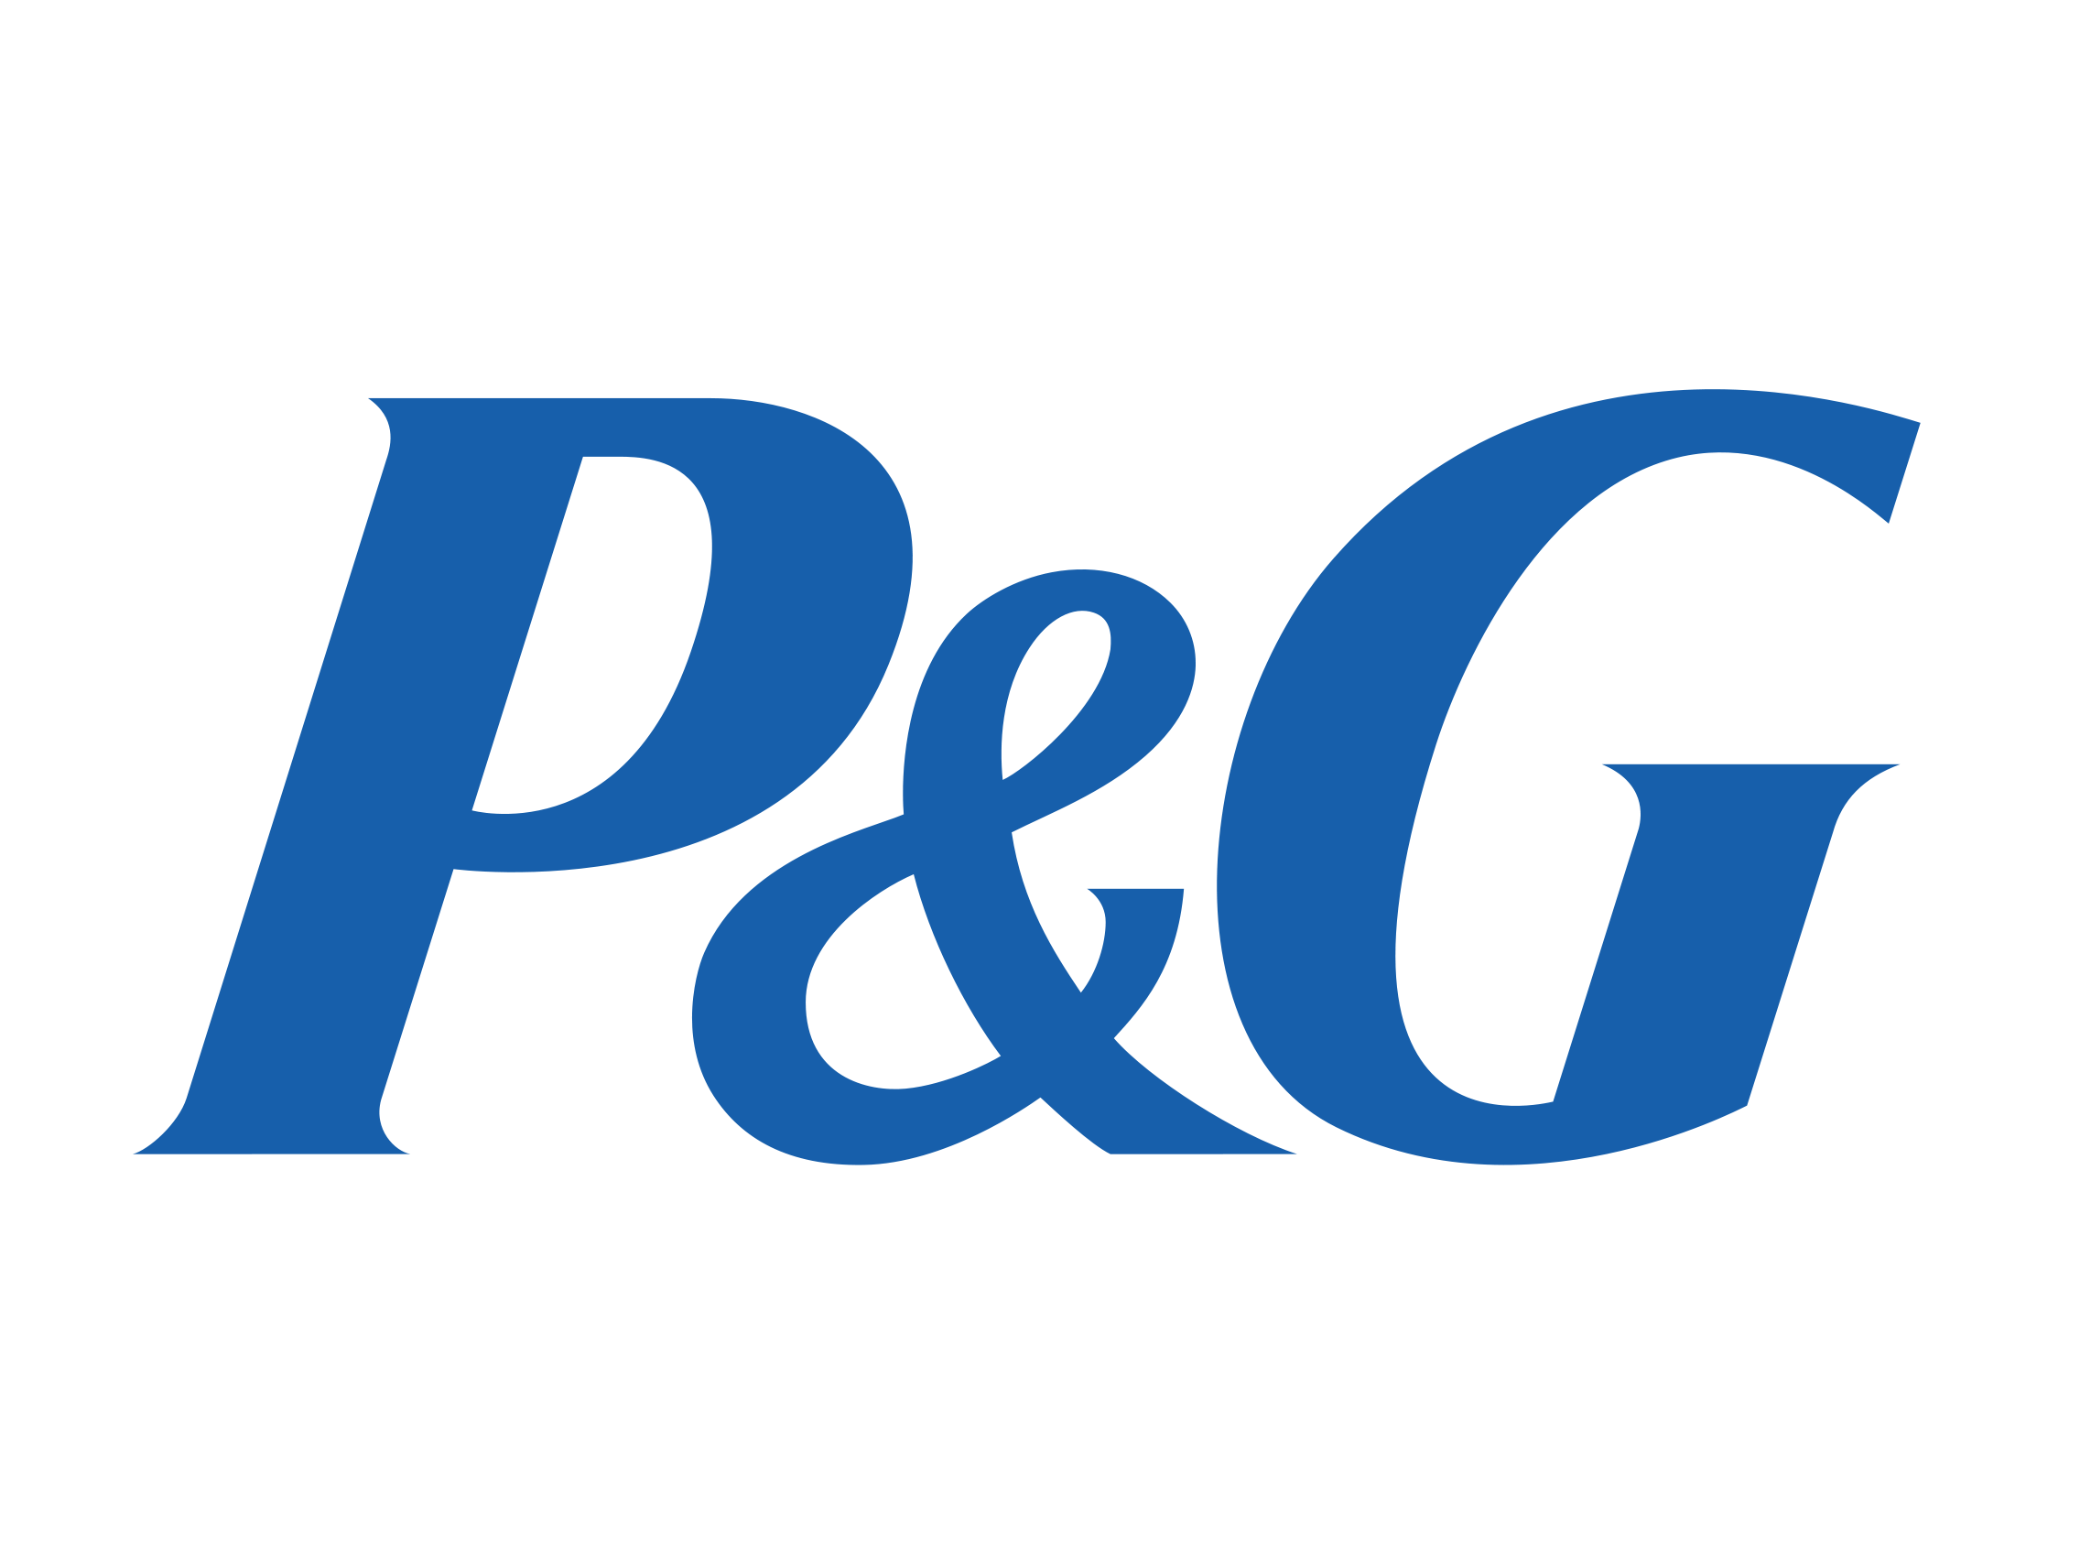

Slide 38
Modifiers
Modifier refers to word, phrase or clause that functions as an adjective or adverb to qualify the meaning of other word.
Regardless of whether corporate, family or individual brands are employed it is often necessary to further distinguish brand according to the different types of items or models involved.
Modifies help communicate how different products within a category that share the same brand name differs on one or more significant attributes or other in the same brand family

Slide 40
Using Cause Marketing to Build Brand Equity
“Cause Related Marketing” or “Cause Marketing” is “the process of formulating and implementing marketing activities that are characterized by an offer from the firm to contribute a specified amount to a designated cause when customers engage in revenue providing exchanges that satisfy organizational and individual objectives.”

Slide 41
Advantages of Cause Marketing
Building brand awareness
Enhancing brand image
Establishing brand credibility
Evoking brand feelings
Creating a sense of brand community
Eliciting brand engagement

Slide 42
Designing Cause Marketing Programs
CSM is not only done through advertising
Product development can also be done, i.e. develop a product purely associated with a cause, a % of sales go out to support this cause.
Some brands position themselves around causes i.e. Women’s Aid has been working with The Body Shop since 2004, as part of their long-running ‘Stop Violence in the Home’ campaign. The campaign aims to raise funds to develop projects that tackle the problem of domestic violence and raise awareness of the issue amongst their customers.

Slide 44
Green Marketing
A special case of cause marketing that is particularly concerned with the environment
Explosion of environmentally friendly products and marketing programs

